Slide 1
RTO Management System Developed in PHP & MySQL

Slide 2
Abstract
RTO Management System is a web-based application that facilitates users in applying for a learning license and driving license. This software has been designed to facilitate the flow of information within an organization. RTO provides the facility of applying for licenses online. RTO Management System is a web application, which is very useful for RTO works completion online. Here we developing such type of software that reduces the RTO work manually and helps to save the time of the user.
The main objective of “RTO Management System” project is to providing easier to RTOs and License holders.

Slide 3
Purpose of the Project
The development of this new system contains the following activities, which try to automate the entire process keeping in the view of database integration approach. This system maintains user’s personal, and contact details. This system will provide on line help and search capabilities. User friendliness is provided in the application with various controls provided by system rich user interface. Authentication is provided for this application only registered users can access. Licences information files can be stored in centralized database which can be maintained by the system. This system provides the users, admin and rto offices to manage the details of RTO data systematically. This system basically lessens the manual work and improves the quality of maintaining records and other information related to RTO offices information. One of the solutions that we are going to discuss here to speed up the database response by using SQL Server database and to reduce the time complexity by using multi-user environment. Multi-user environment reduces burden with effortless maintenance.

Slide 4
Scope of the Project
The objective of this application is to develop a system that effectively manages all the data related to the RTO offices like details of learning licence, details of driving licence and details of RTO offices. The purpose is to maintain a centralized database of all RTO office related information. The goal is to support various functions and processes necessary to manage the data efficiently.
Existing System
This existing system is not providing secure registration and profile management of all the users properly. This system is not providing on-line Help. This system doesn’t provide tracking of users activities and their progress. This manual system gives us very less security for saving data and some data may be lost due to mismanagement. This system is not providing RTO work management through internet. This system is not providing proper RTO work information.

Slide 5
Project Modules
In Bank Locker Management System we used PHP and MySQL database. This project has three modules i.e. Banker, Sub-banker and User
User Module
In this project user is those who have locker in bank. With the help of locker number user can see the details of lockers.

Slide 6
Admin Module
Dashboard: In this section, admin can see all detail in brief like the total registered users, Total Learning License Application, Total Driving License Application, Total State, Total City, Total Read Enquiry and Total Unread Enquiry.
State: In this section, admin can manage state(add/delete/update).
City: In this section, admin can manage city(add/delete/update).
RTO: In this section, admin can manage rto(add/delete/update).
Pages: In This section, admin can manage websites pages.
Licence Application:
Learning License: In this section, admin can view the learning license application which is sent by registered users.
Driving License: In this section, admin can view the driving license application which is sent by registered users.
Enquiry: In this section, admin can view and maintain the enquiry.
Report: In this section, admin between dates report of learning licence and driving licence.
Search:
Search Learning Licence: In this section, admin can search learning licence application by help of application number and by name.
Search Driving Licence: In this section, admin can search driving licence application by help of application number and by name.
View Reg Users: In this section, admin view the detail of registered users.
Admin can also update his profile, change password and recover password.

Slide 7
User Module
Dashboard: This is welcome page of user.
Apply For New Licence: In this section, user can sent learning or driving licence request.
My Accounts: In this section, user can view and update the his/her profile and password.
Request History: In this section, user can check the status of applied application.
About Us: In this section, user can view the details of website.
Contact Us: In this section, user can send the enquiry.
User can also update his profile, change password and recover password.

Slide 8
RTO Office Module
Dashboard: In this section, RTO officer can see all detail in brief like Total New Learning License Application, Total Accepted Learning License Application , Total Rejected Learning License Application ,Total New Driving License Application, Total Accepted Driving License Application, Total Rejected Driving License Application.
Learning Licence Request: In this section, RTO officer can manage Learning Licence request which is sent by registered users.
Driving Licence Request: In this section, RTO officer can manage Driving Licence request which is sent by registered users.
Report: In this section, RTO officer between dates report of learning licence and driving licence.
Search:
a. Search Learning Licence: In this section, admin can search learning licence application by help of application number and by name.
b. Search Driving Licence: In this section, admin can search driving licence application by help of application number and by name.
RTO officer can view rto details, change password and recover password.

Slide 9
Requirement Specification
Hardware Configuration:
Client Side
Server Side
RAM | 512 MB
Hard Disk | 10GB
Processor | 1.0 GHz
RAM | 1 GB
Hard Disk | 20GB
Processor | 2.0GHz

Slide 10
Continue.....
Software Requirement:
Client Side
Server Side
Web Browser | Google Chrome or any compatible browser
Operating System | Windows or any equivalent OS
Web Server | APACHE
Server side Language | PHP5.6 or above version
Database Server | MySQL
Web Browser | Google Chrome or any compatible browser
Operating System | Windows or any equivalent OS

Slide 11
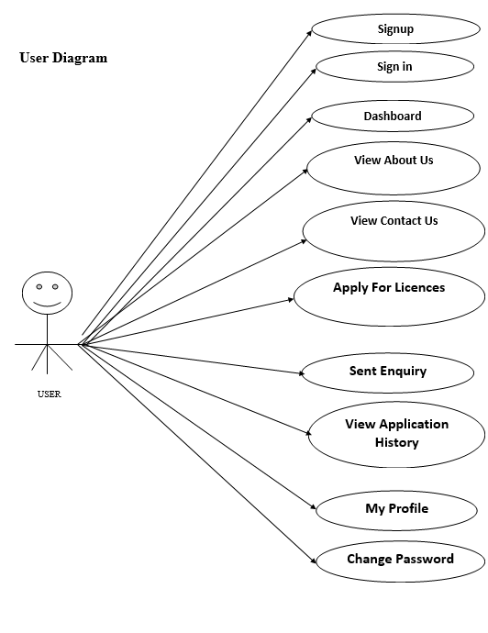
Use Case Diagram
Notes:
USECASE DIAGRAM: A Use case is a description of set of sequence of actions. Graphically it is rendered as an ellipse with solid line including only its name. Use case diagram is a behavioral diagram that shows a set of use cases and actors and their relationship. It is an association between the use cases and actors. An actor represents a real-world object. Primary Actor – Sender, Secondary Actor Receiver.

Slide 12
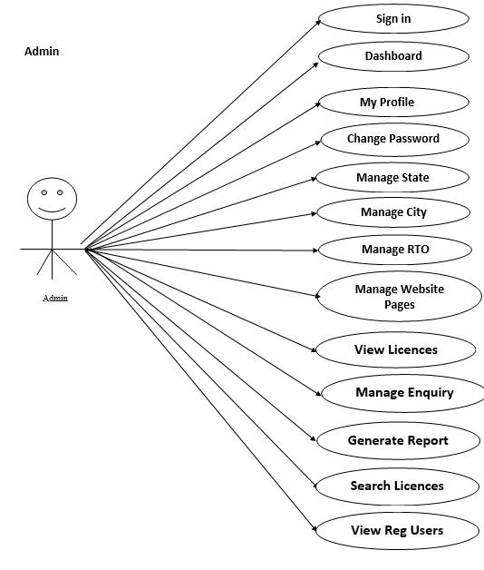
Continue…

Slide 13
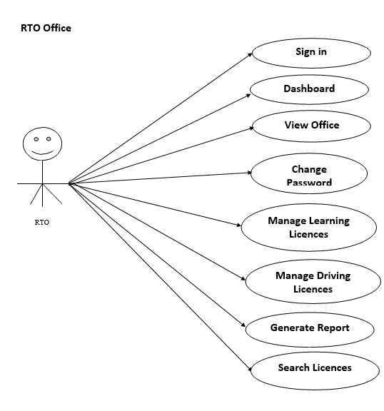
Continue…

Slide 14
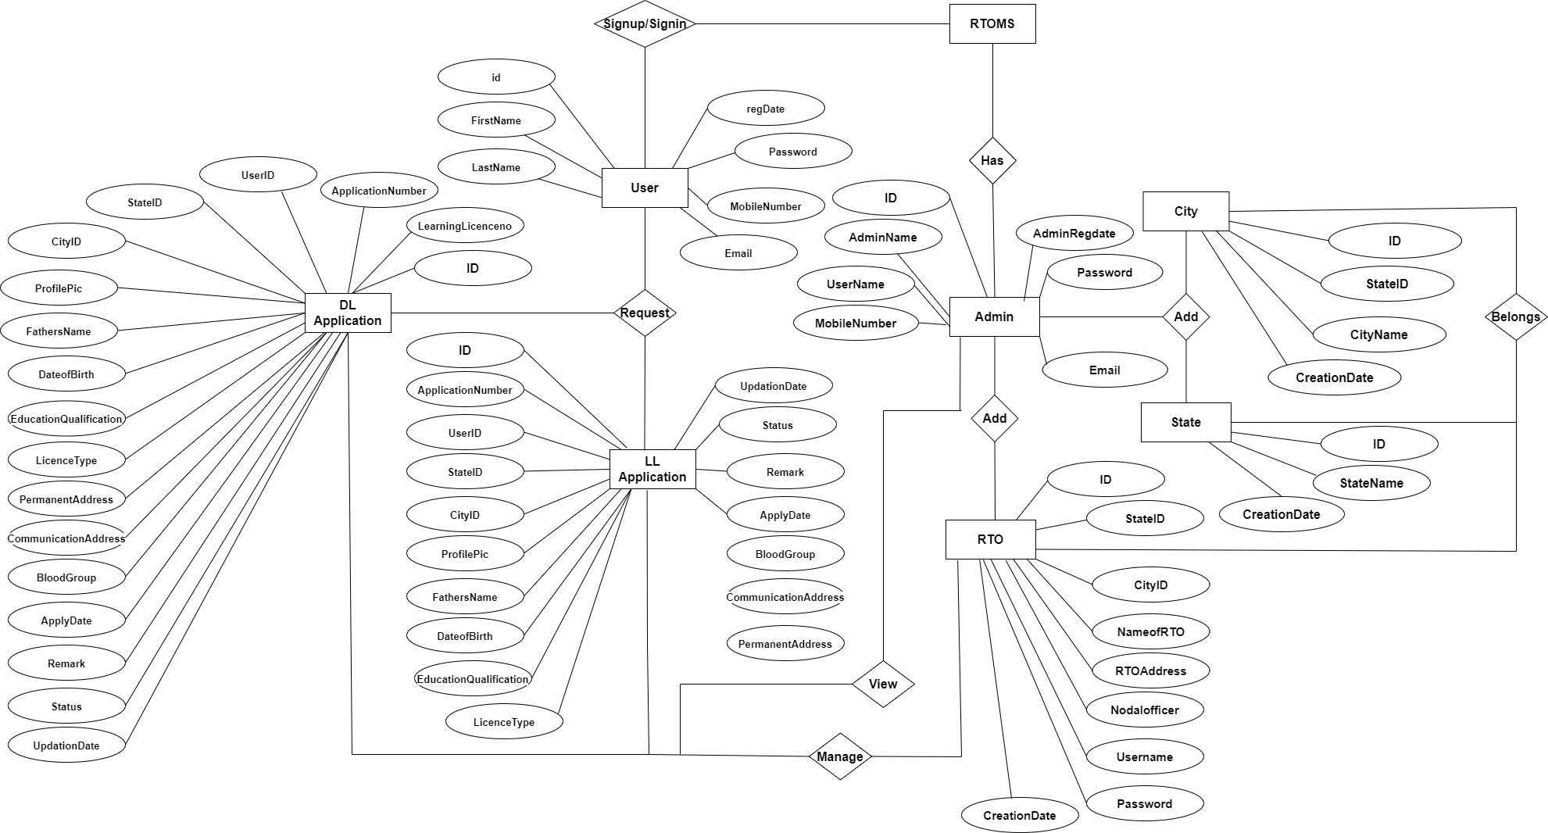
ER Diagram

Slide 15
Dataflow Diagrams (DFDs)
A Data Flow Diagram (DFD) is a traditional visual representation of the information flows within a system. A neat and clear DFD can depict the right amount of the system requirement graphically. It can be manual, automated, or a combination of both.
It shows how data enters and leaves the system, what changes the information, and where data is stored.
The objective of a DFD is to show the scope and boundaries of a system as a whole. It may be used as a communication tool between a system analyst and any person who plays a part in the order that acts as a starting point for redesigning a system. The DFD is also called as a data flow graph or bubble chart.

Slide 16
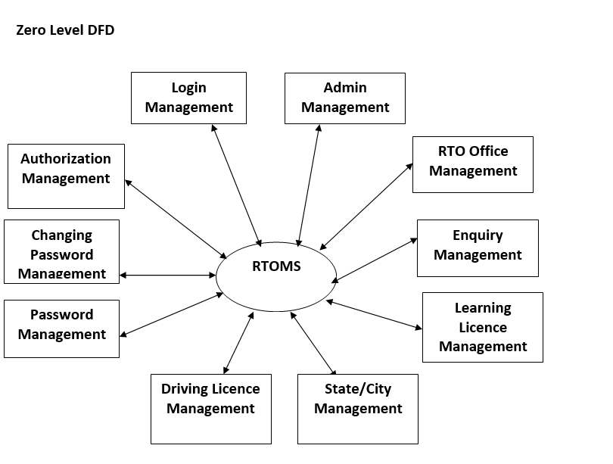
Zero level

Slide 17
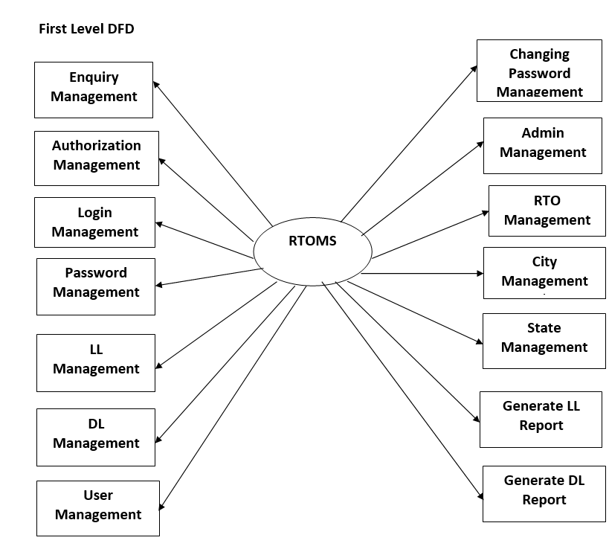
First level

Slide 18
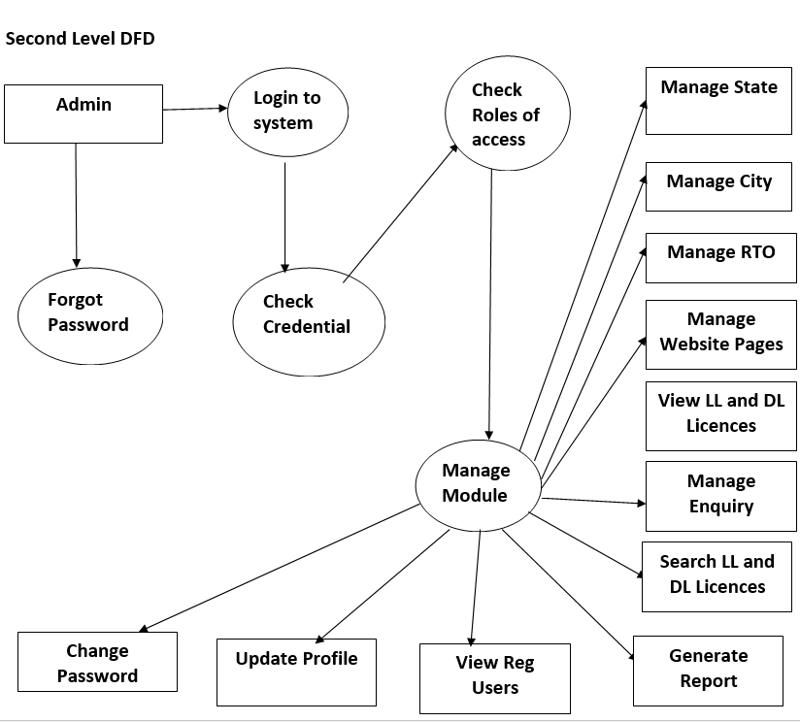

Slide 19
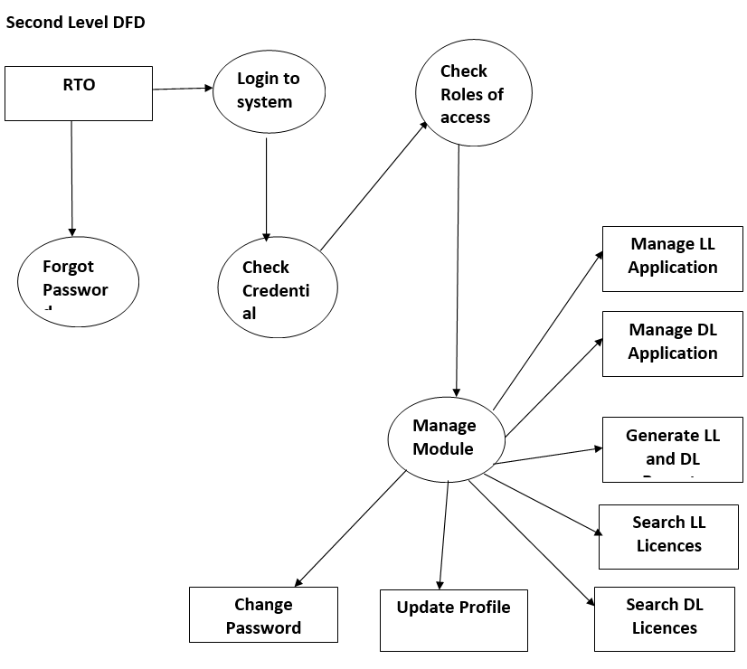

Slide 20
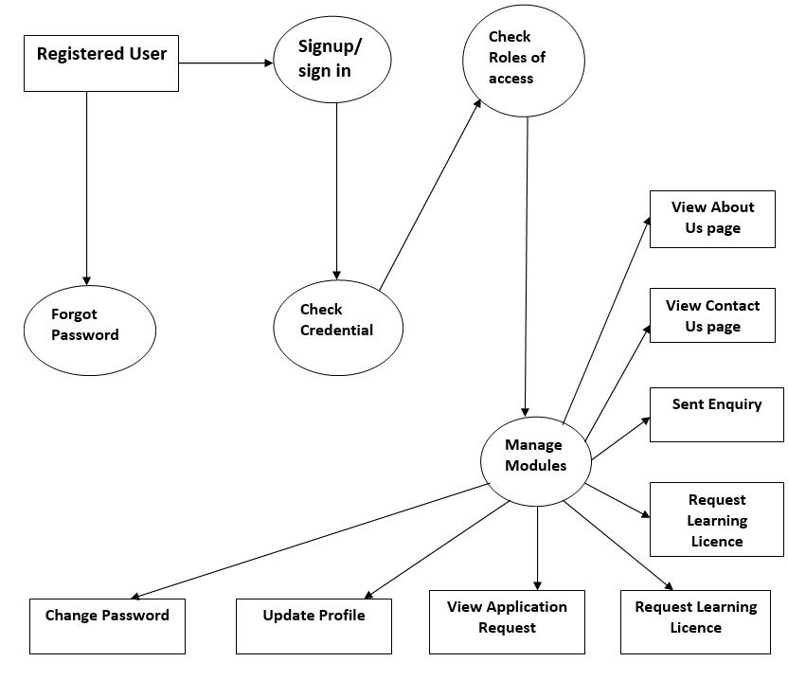

Slide 21
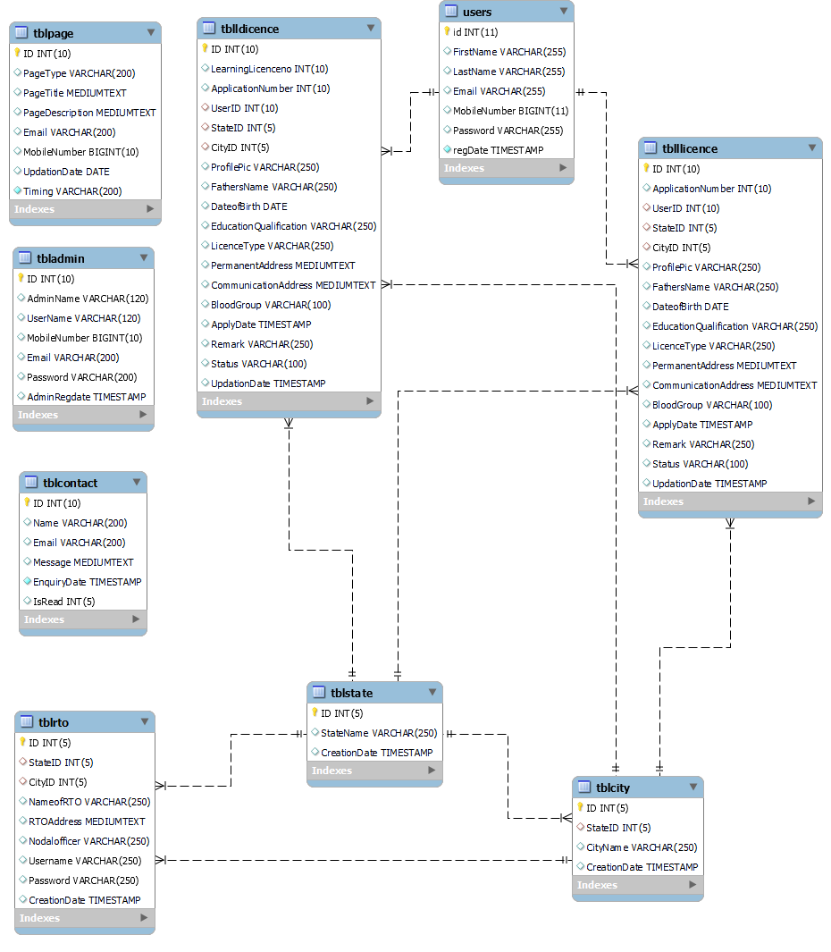
Class Diagram
Notes:
The class diagram shows a set of classes, interfaces, collaborations and their relationships.

Slide 22
Implementation and System Testing
After all phase have been perfectly done, the system will be implemented to the server and the system can be used.
System Testing
The goal of the system testing process was to determine all faults in our project .The program was subjected to a set of test inputs and many explanations were made and based on these explanations it will be decided whether the program behaves as expected or not. Our Project went through two levels of testing
Unit testing
Integration testing

Slide 23
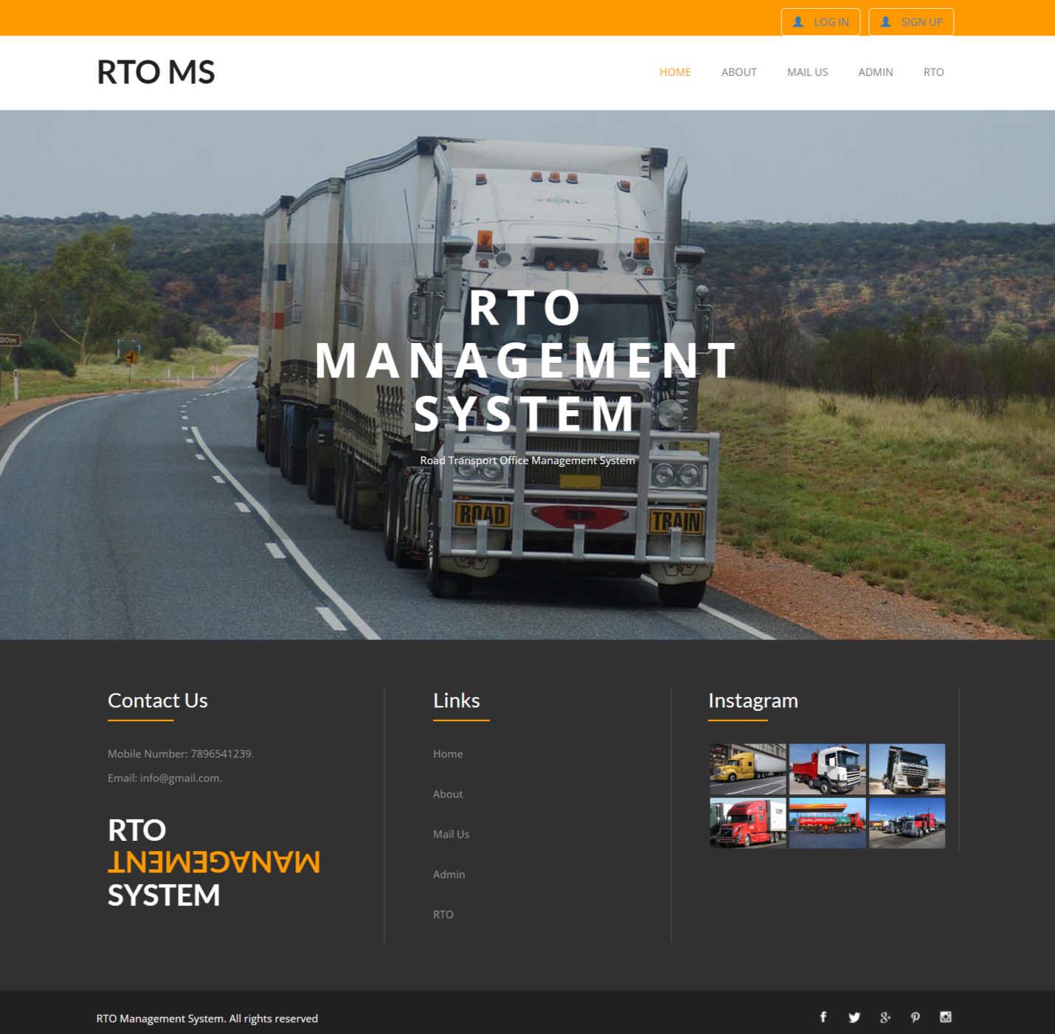
Project Screens

Slide 24
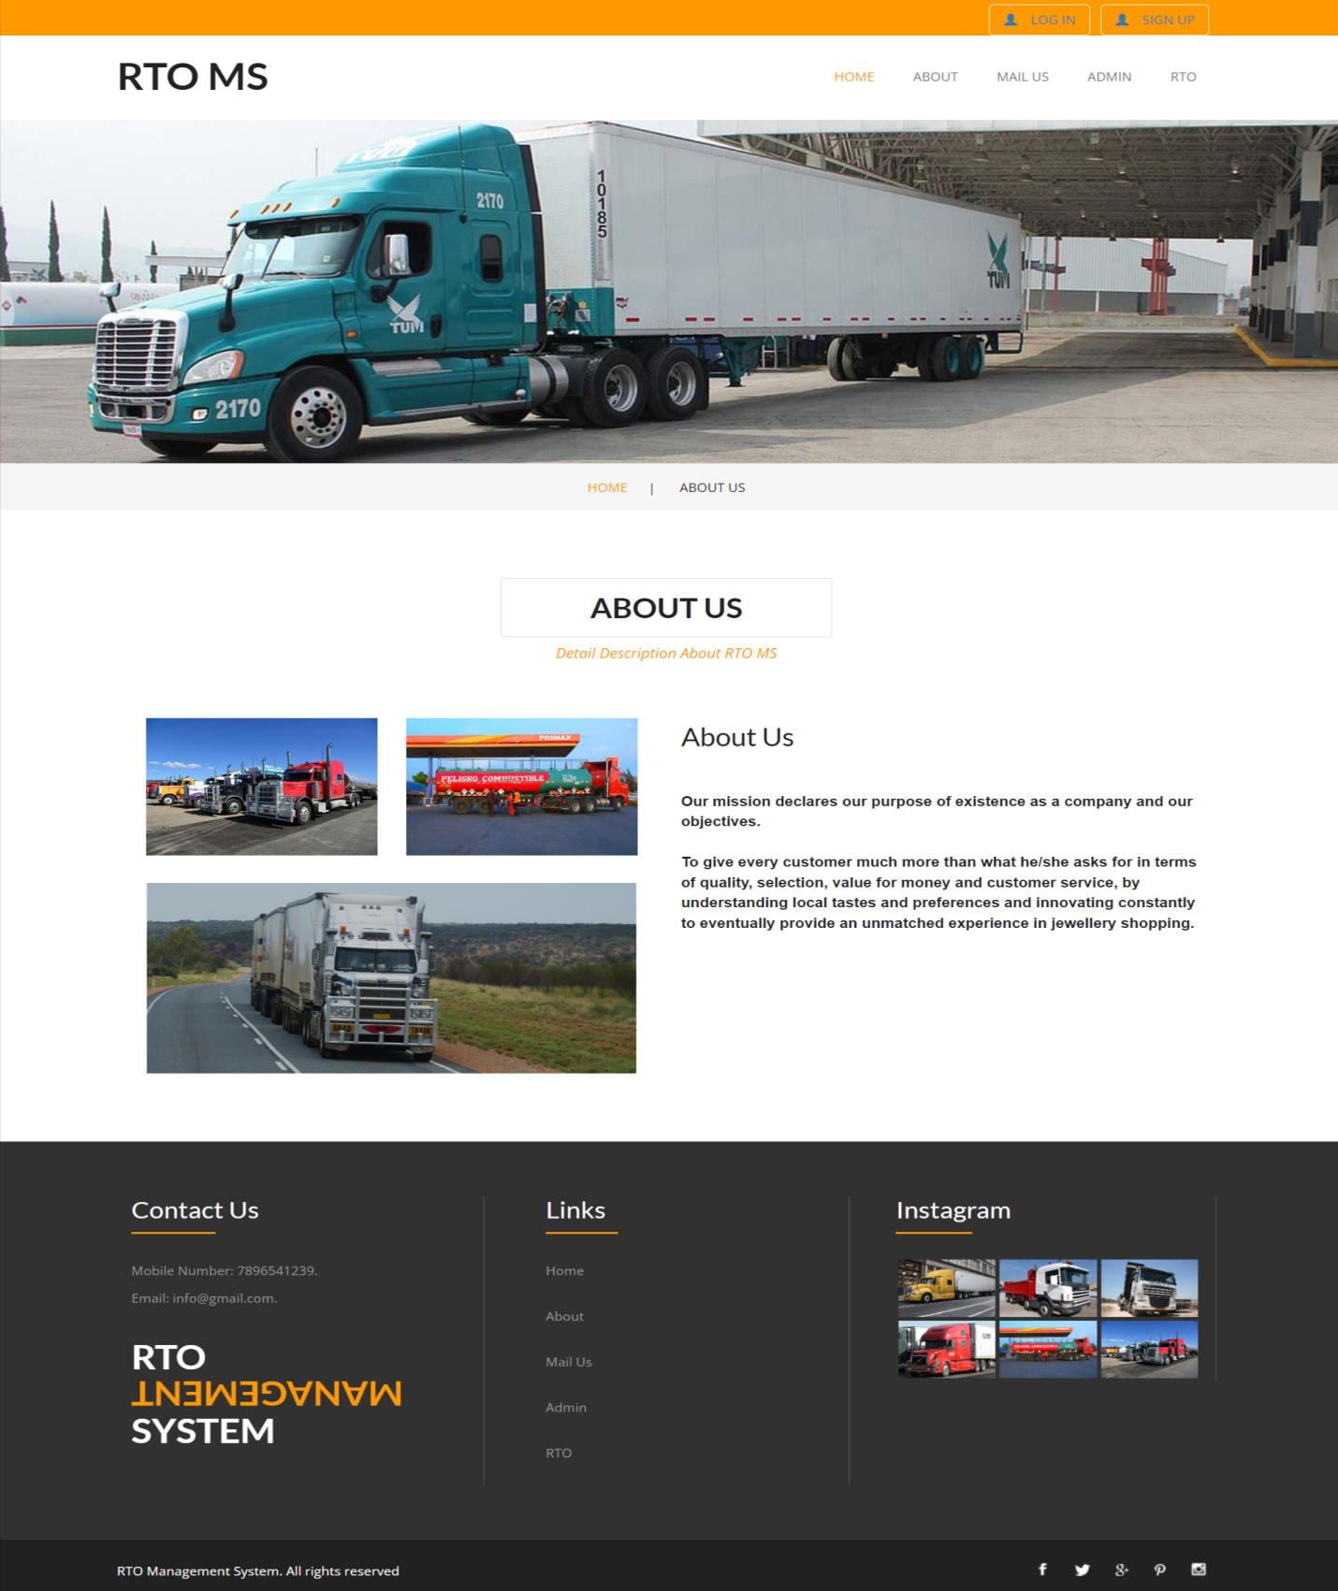

Slide 25
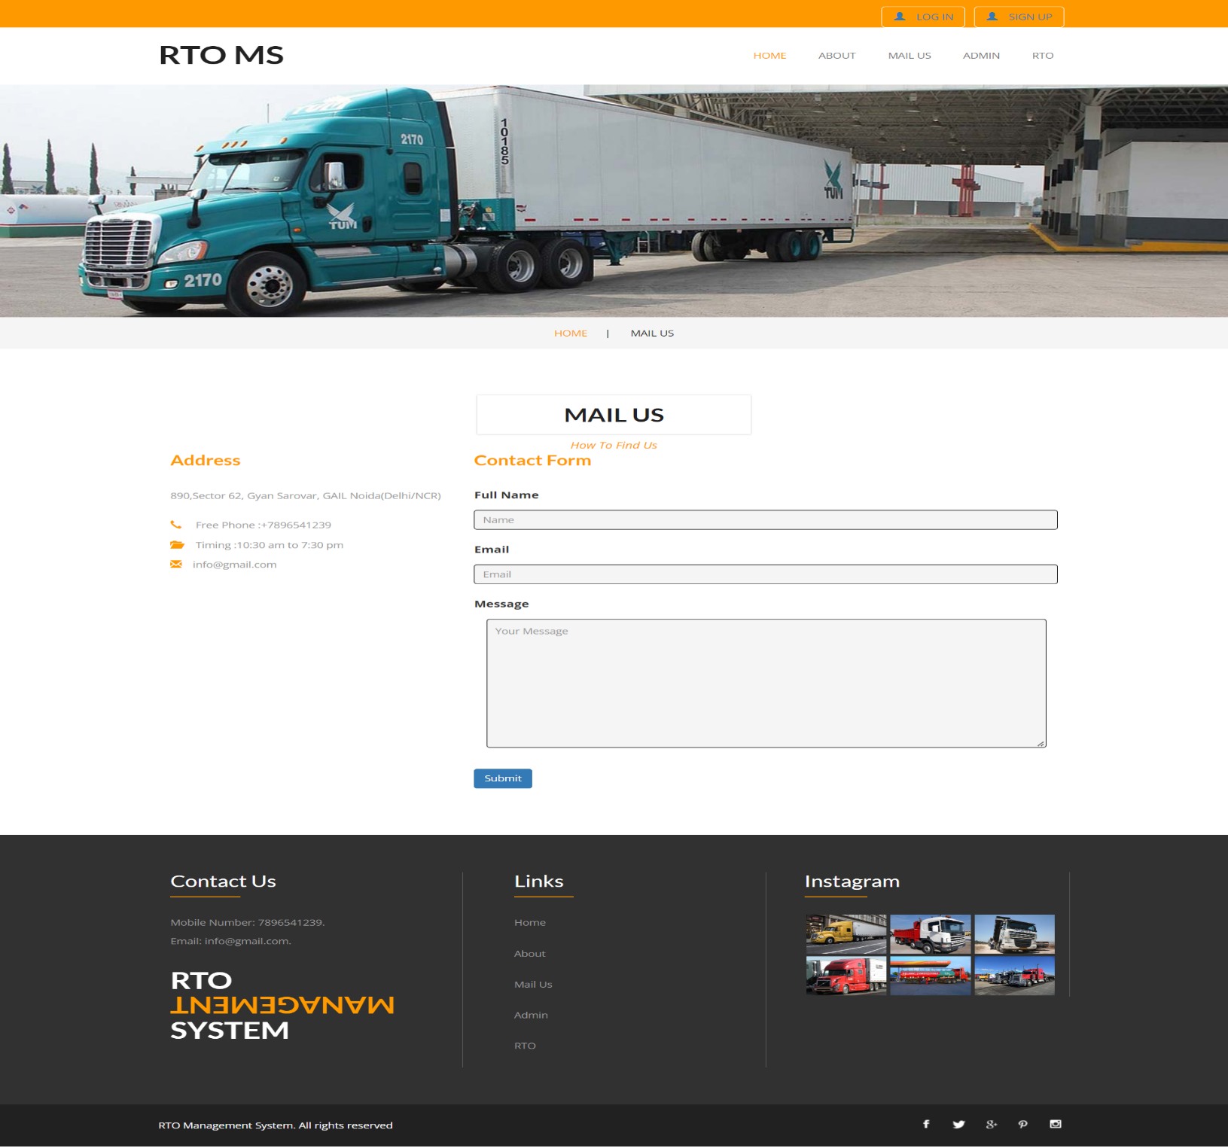

Slide 26
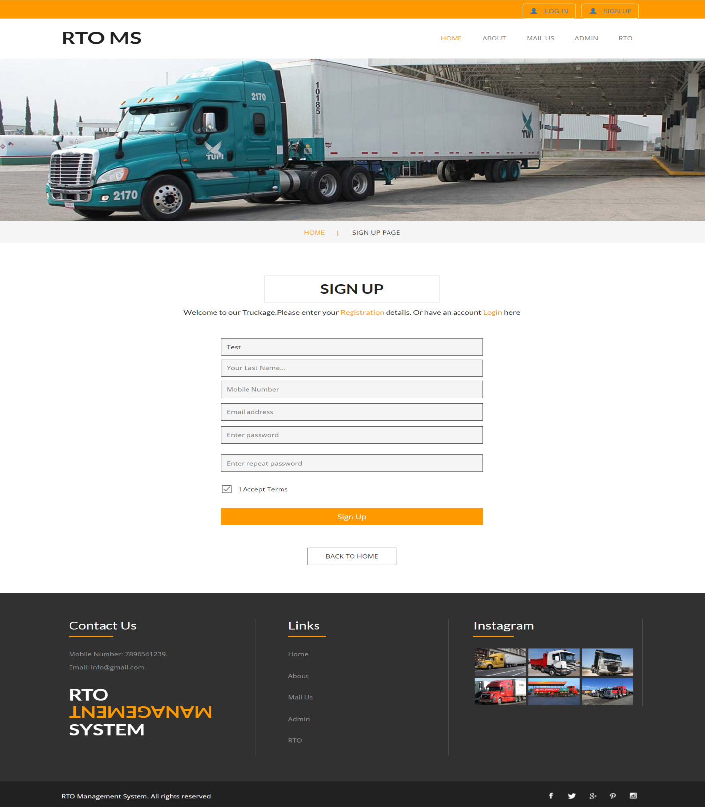

Slide 27
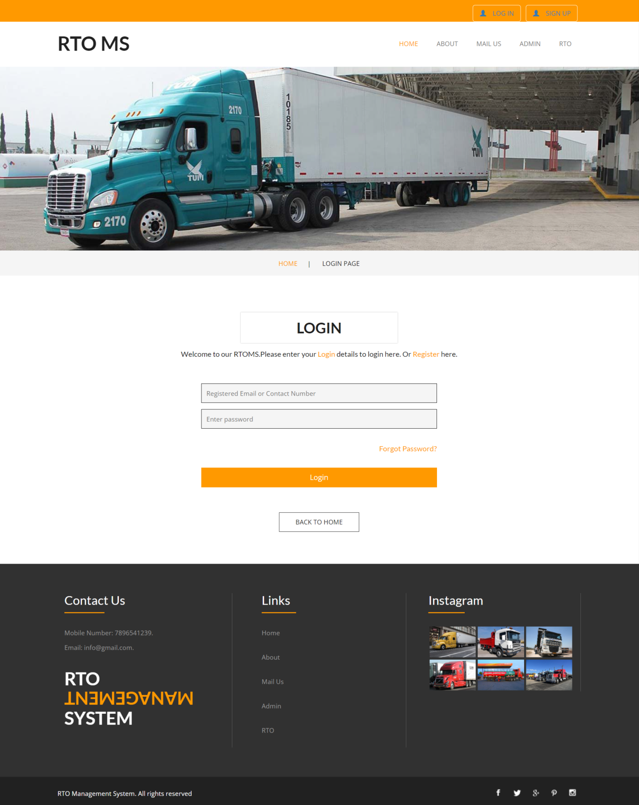

Slide 28
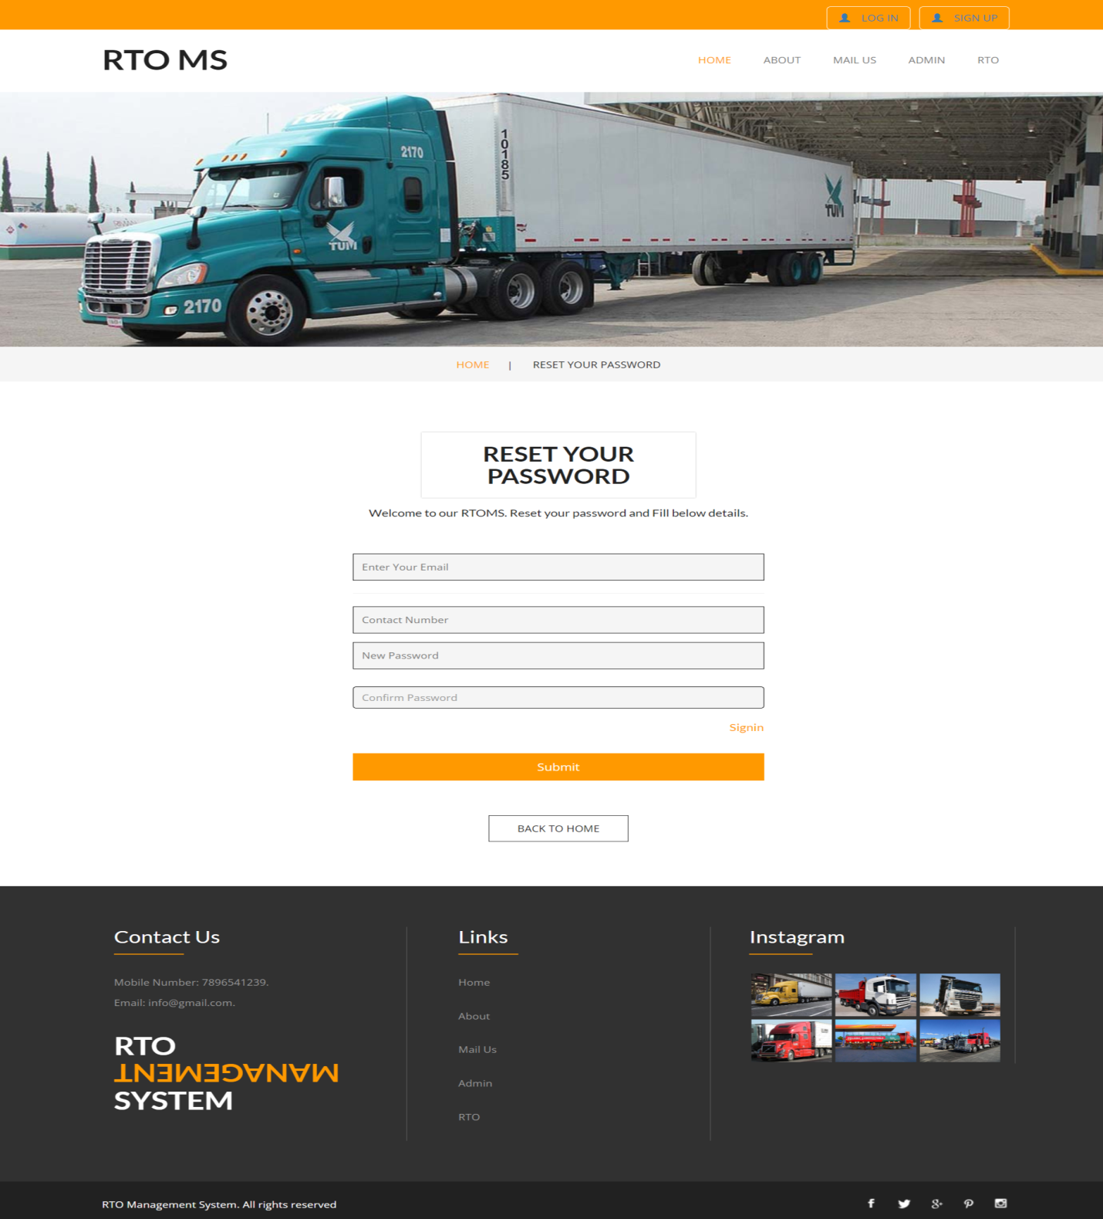

Slide 29
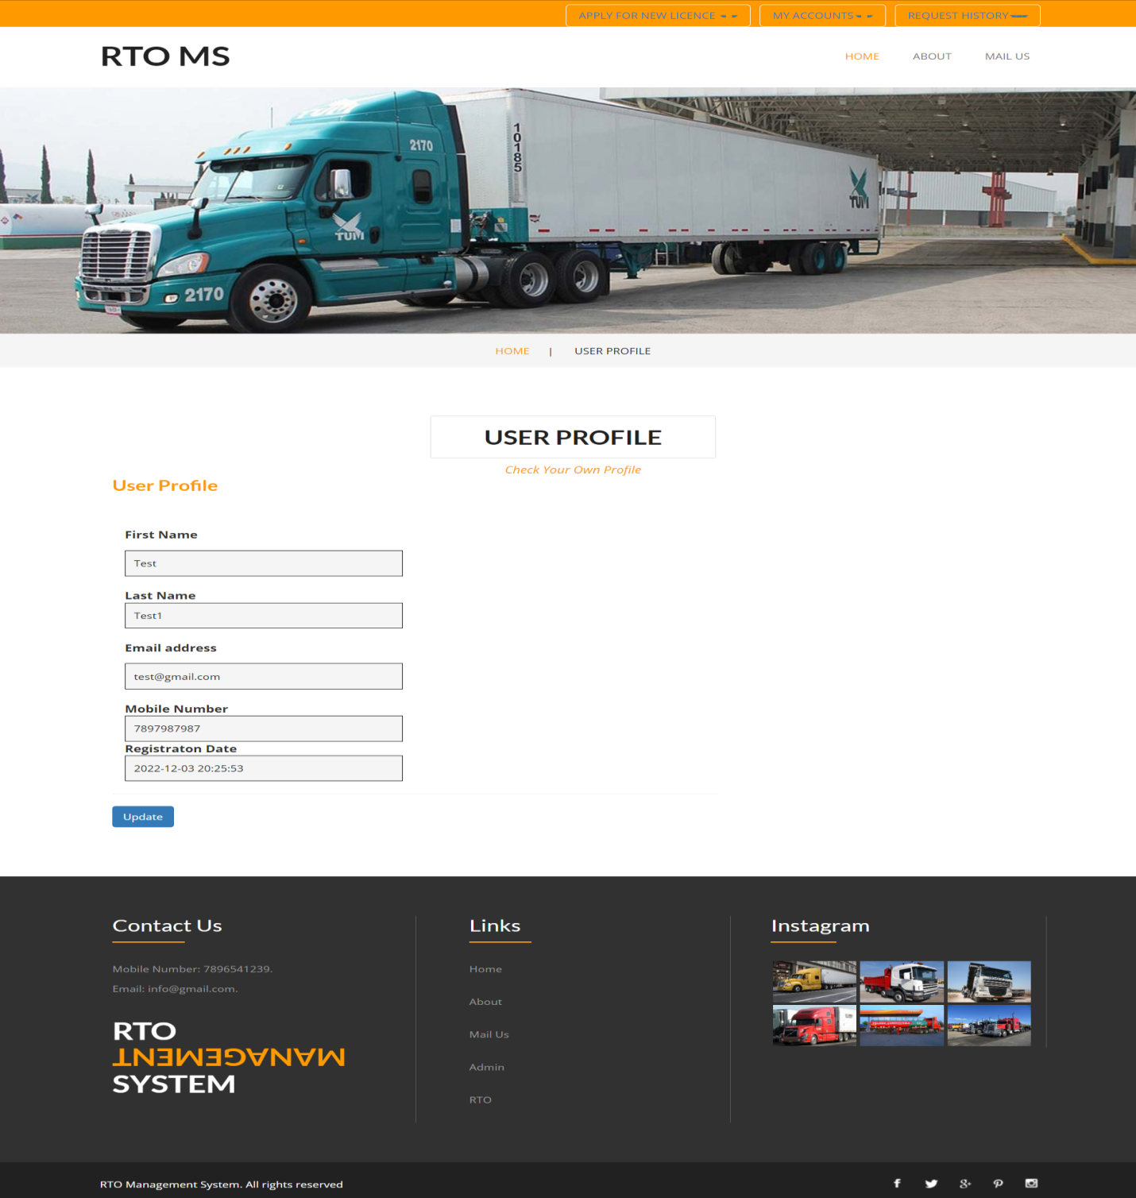

Slide 30
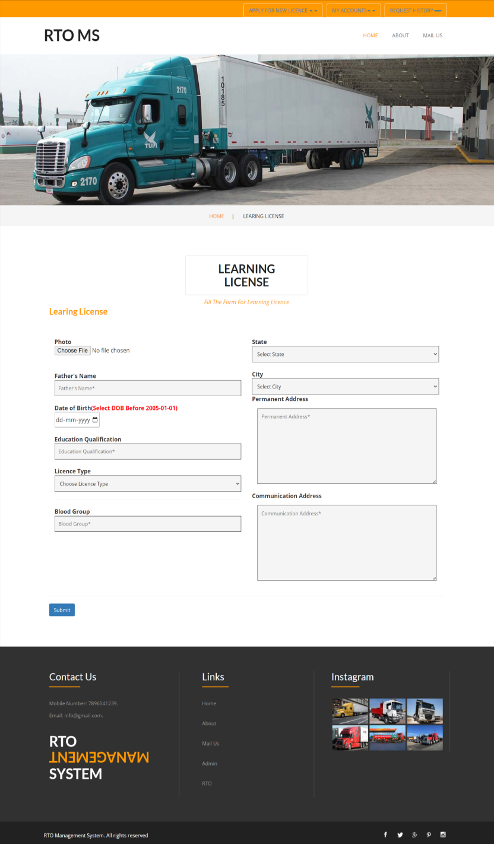
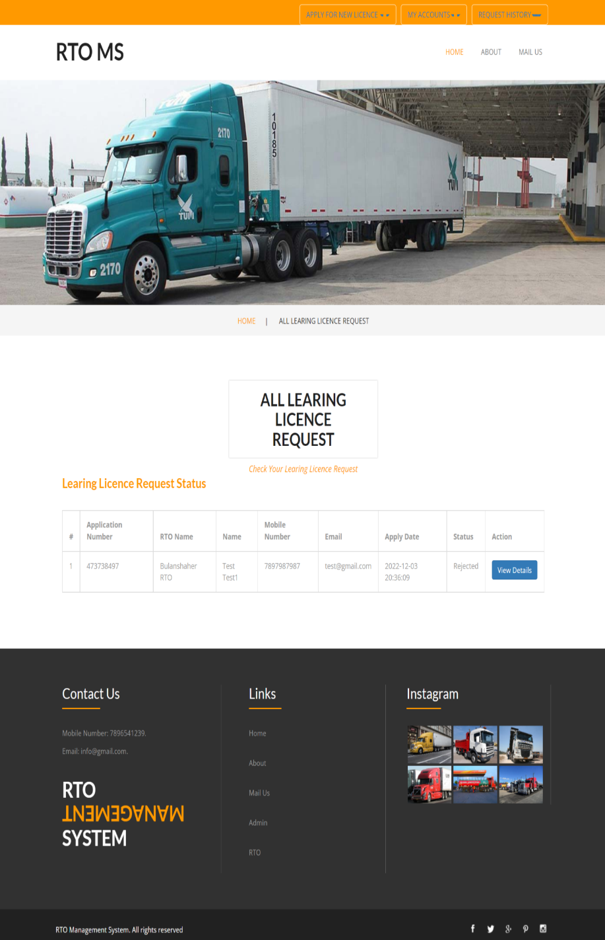

Slide 31
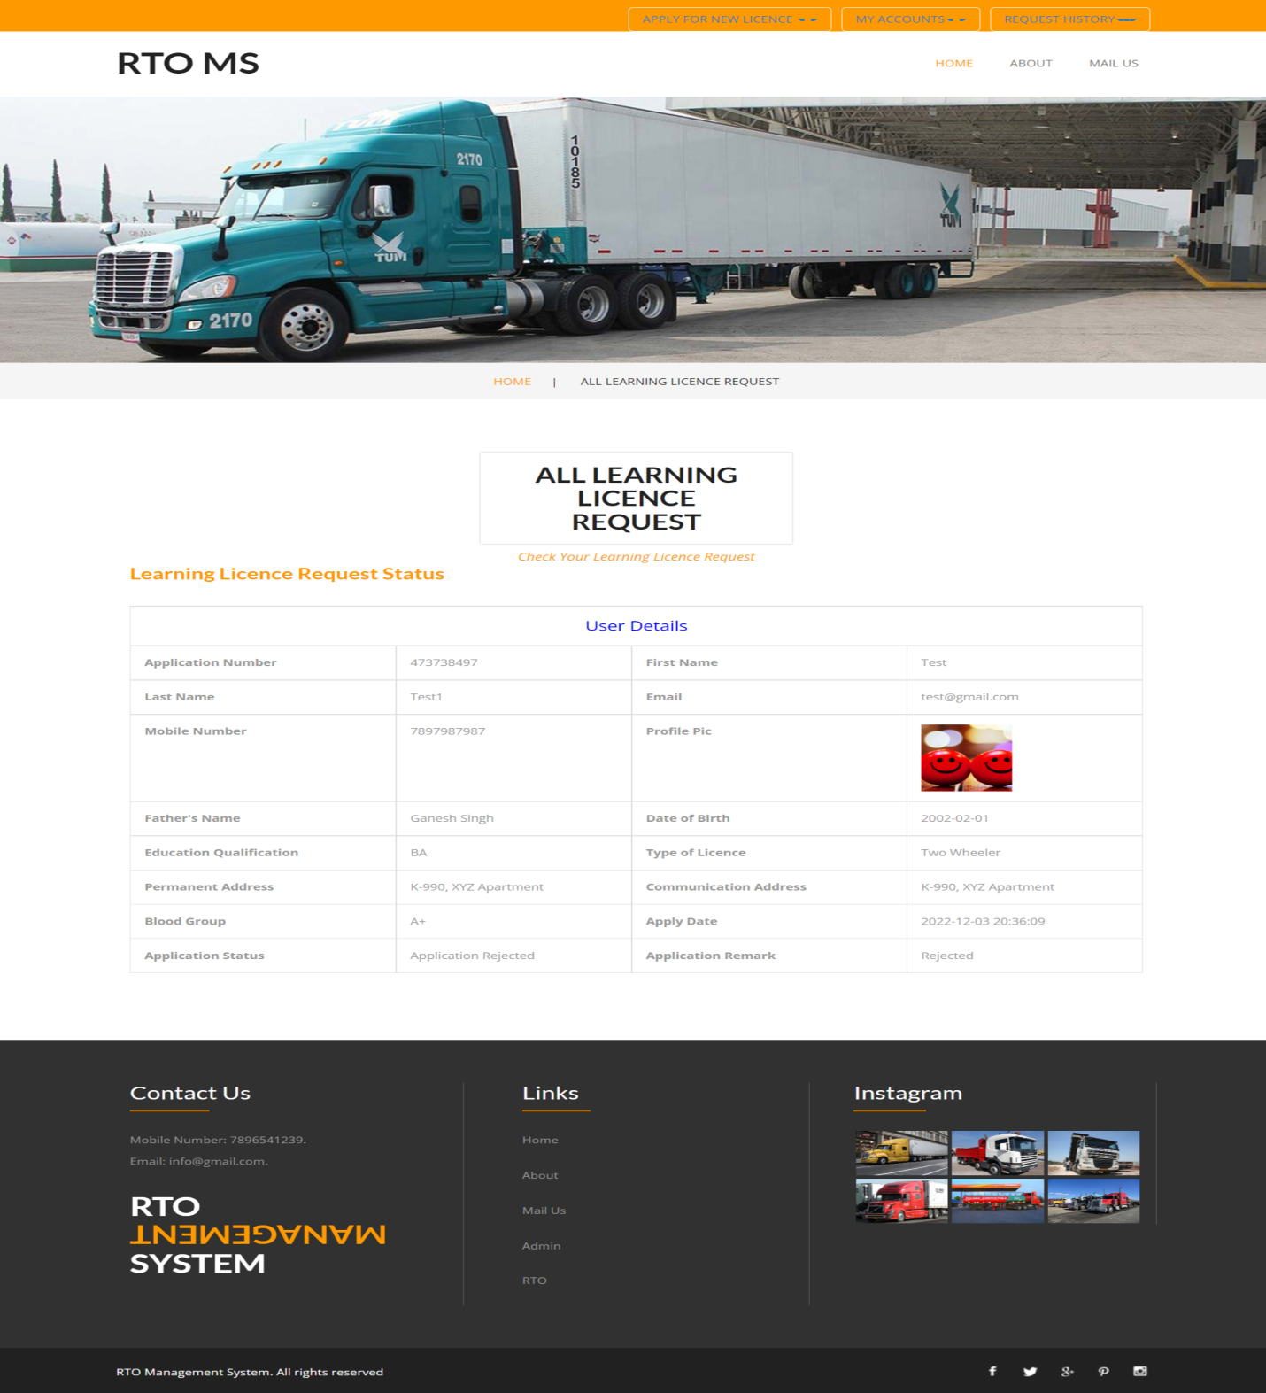

Slide 32
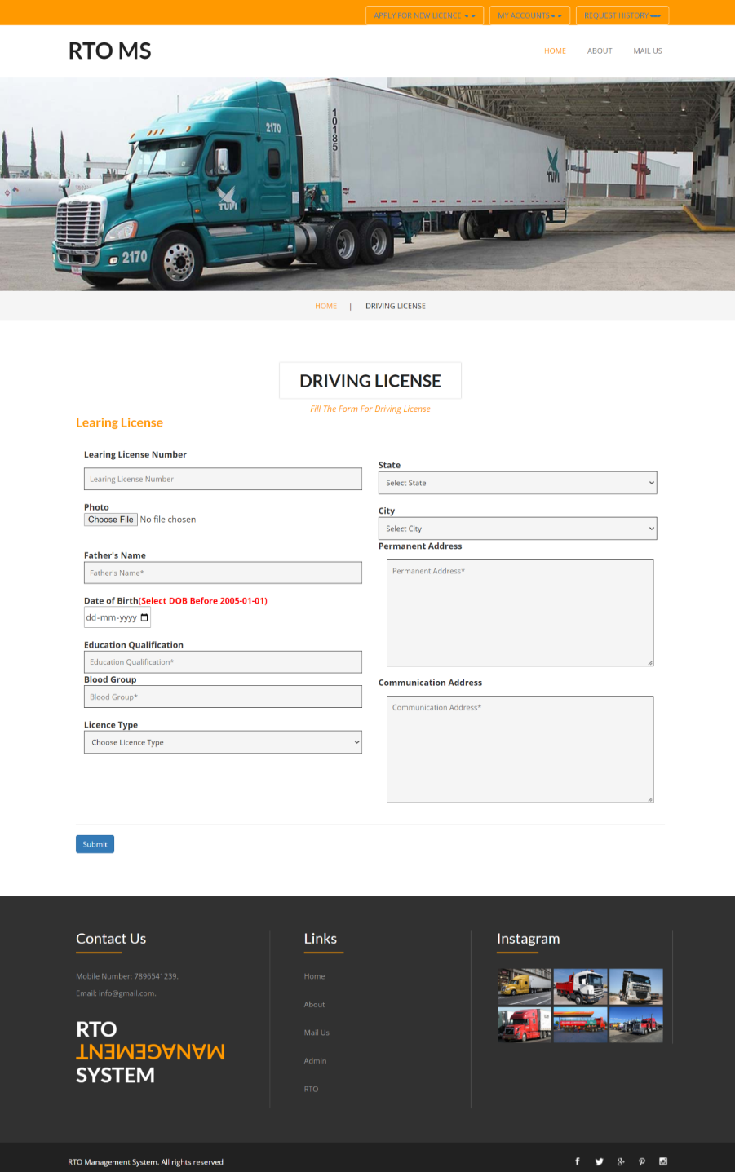


Slide 33
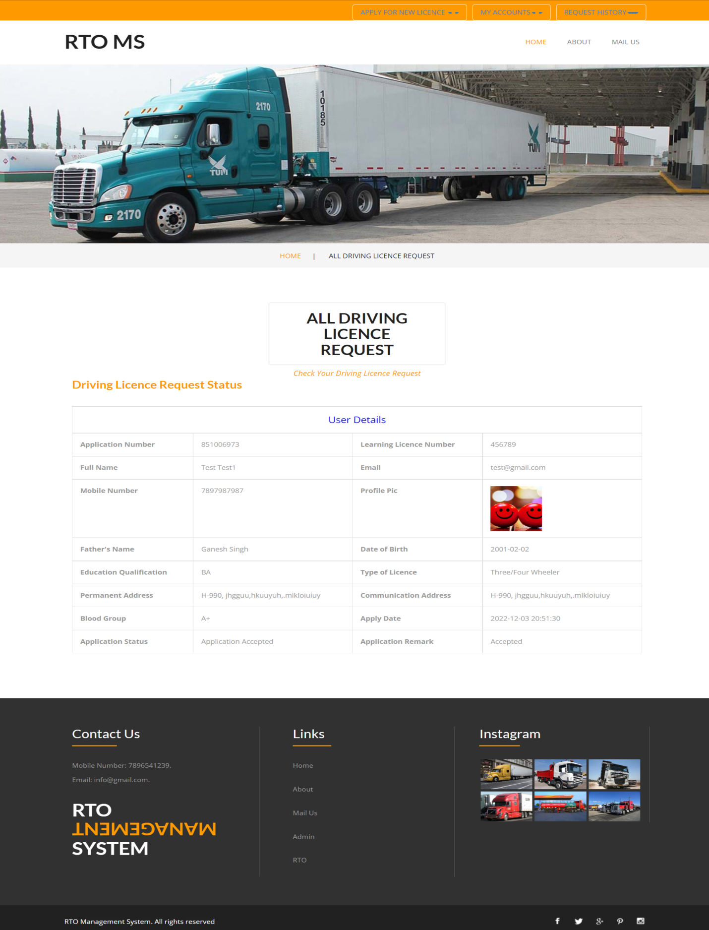

Slide 34




Slide 35
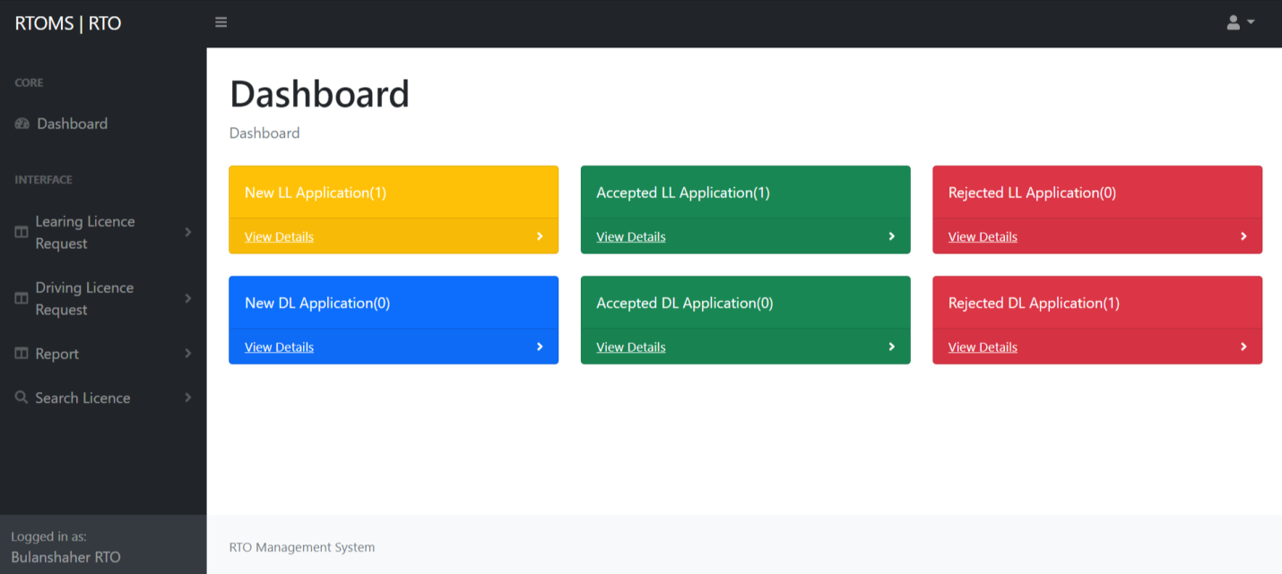
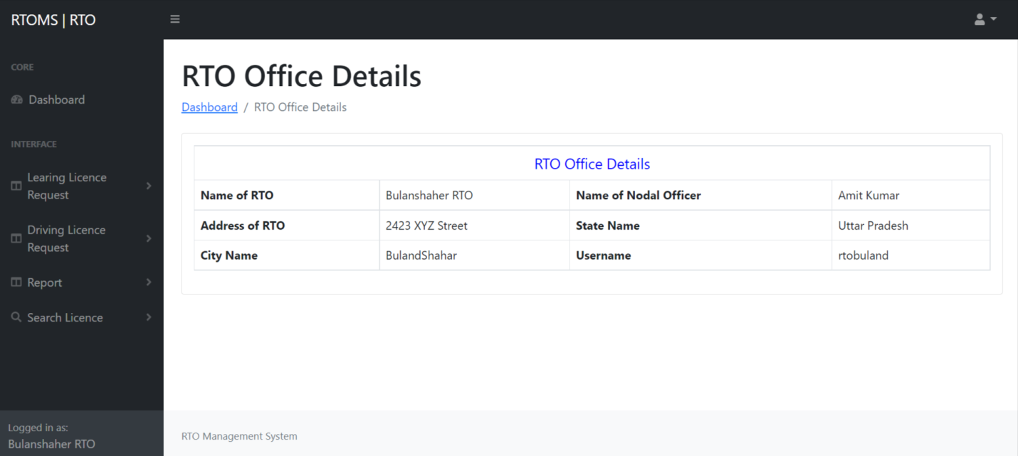

Slide 36
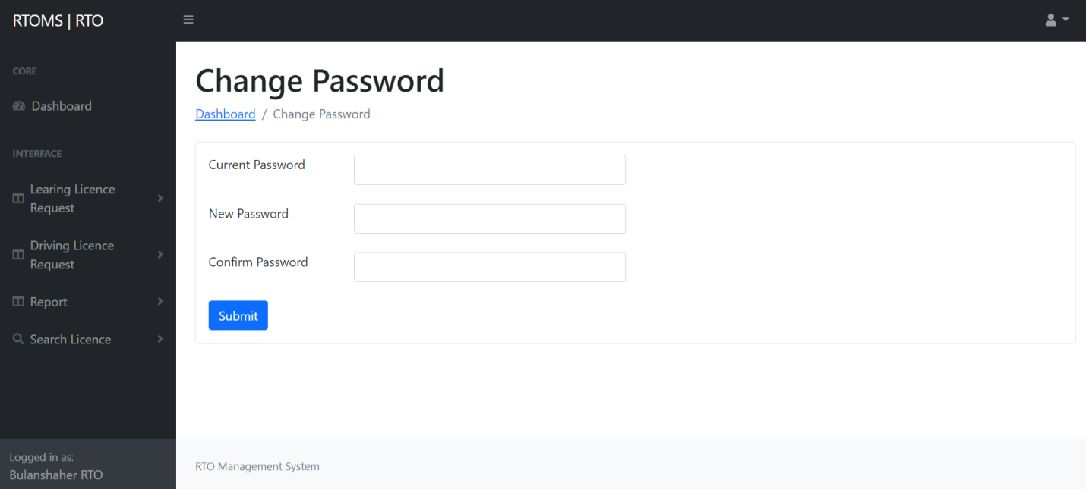
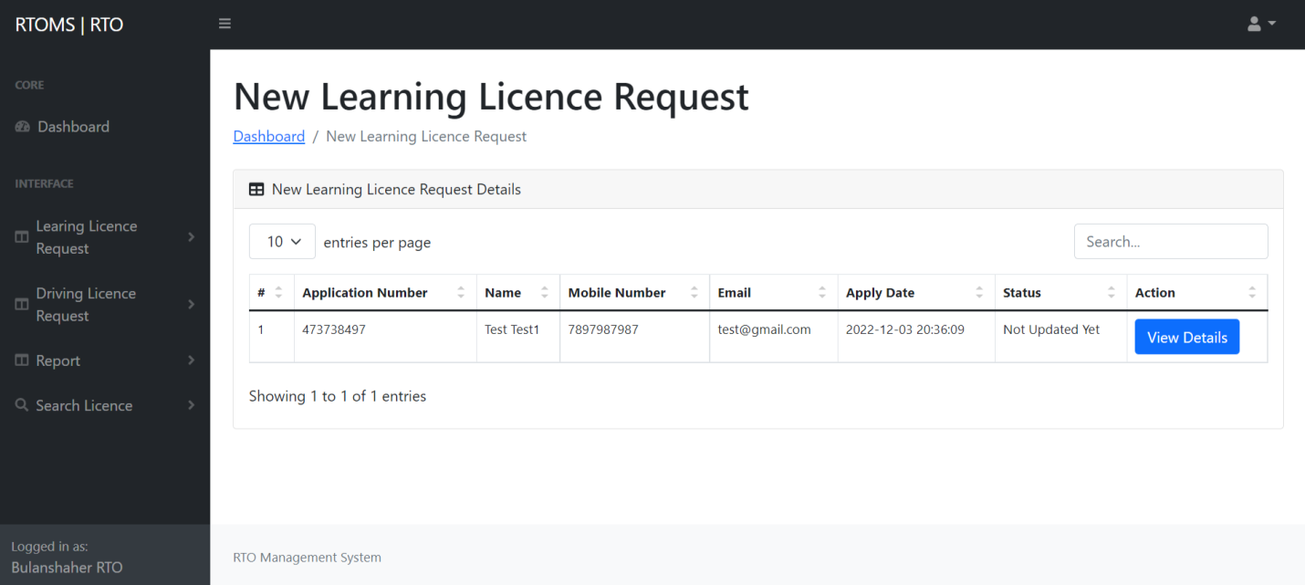

Slide 37
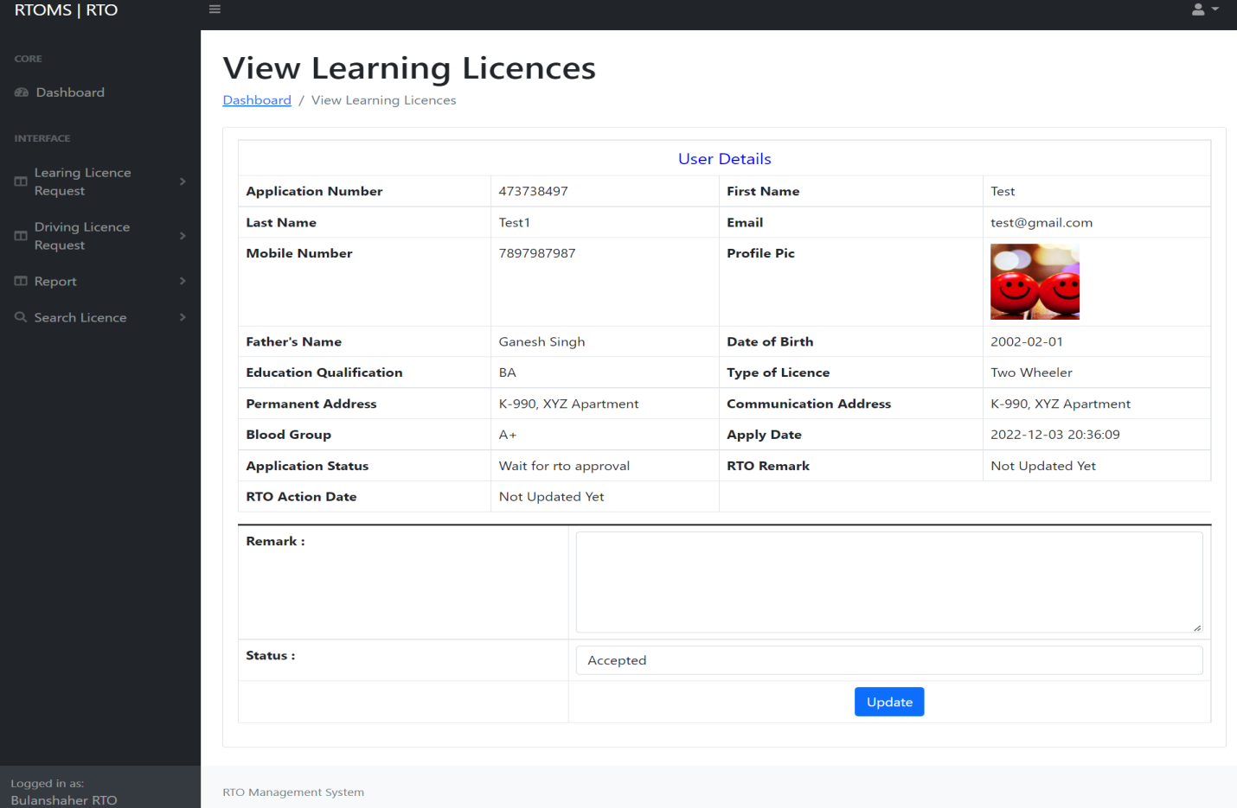
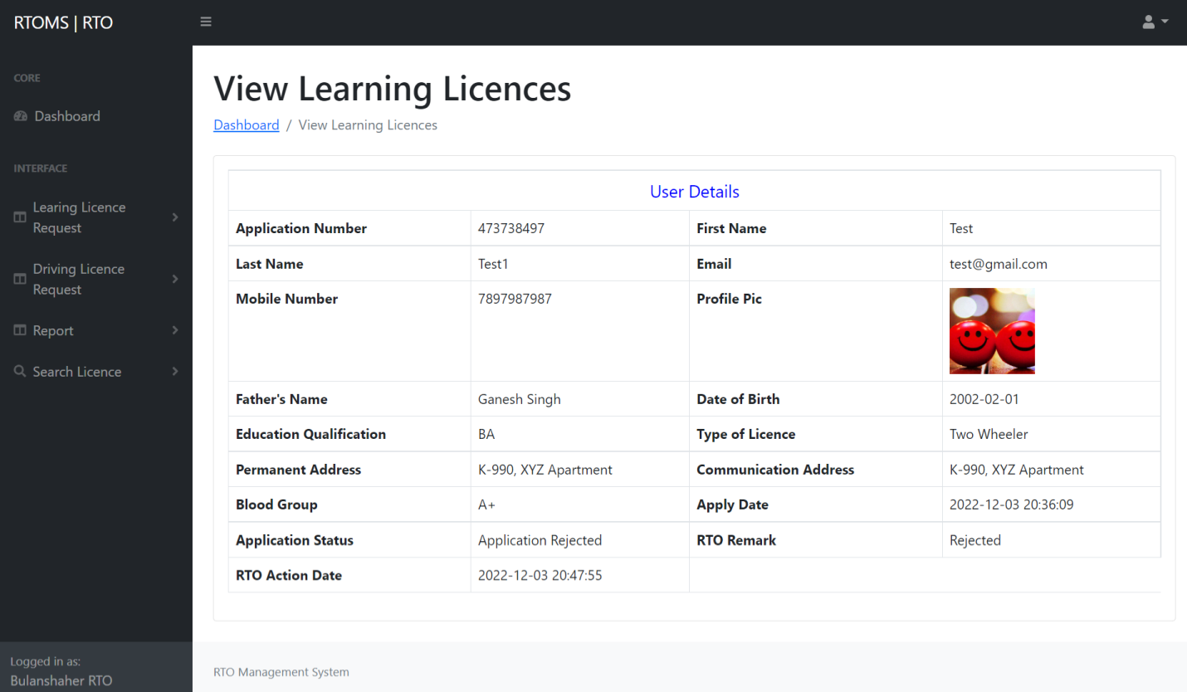

Slide 38

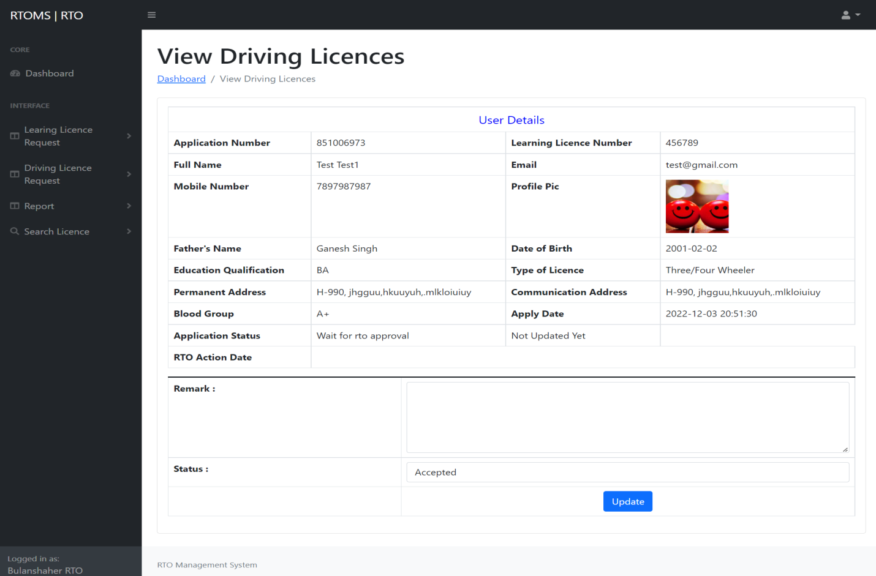

Slide 39
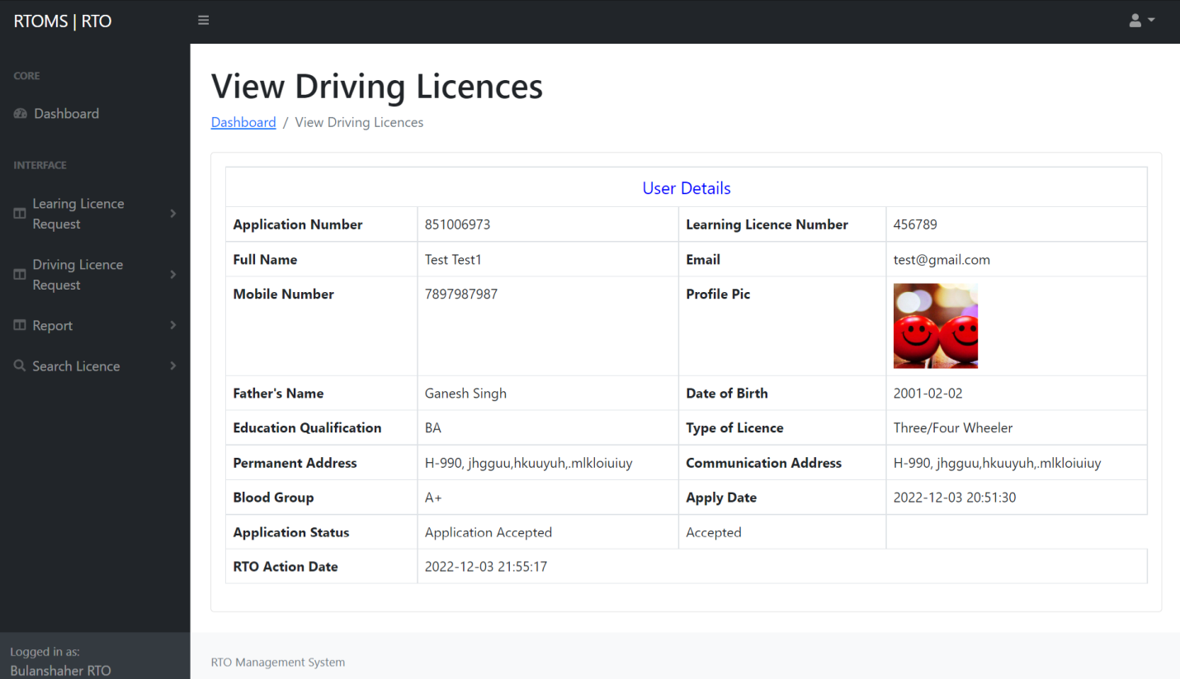
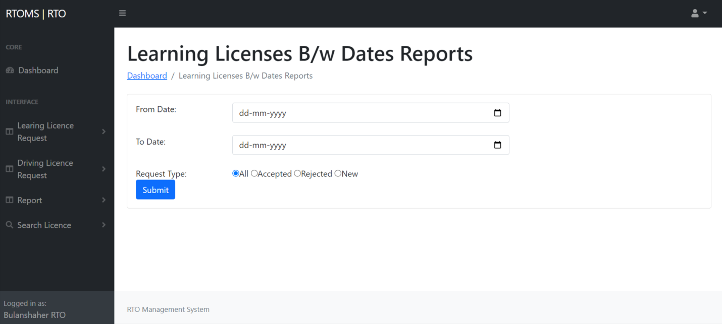

Slide 40
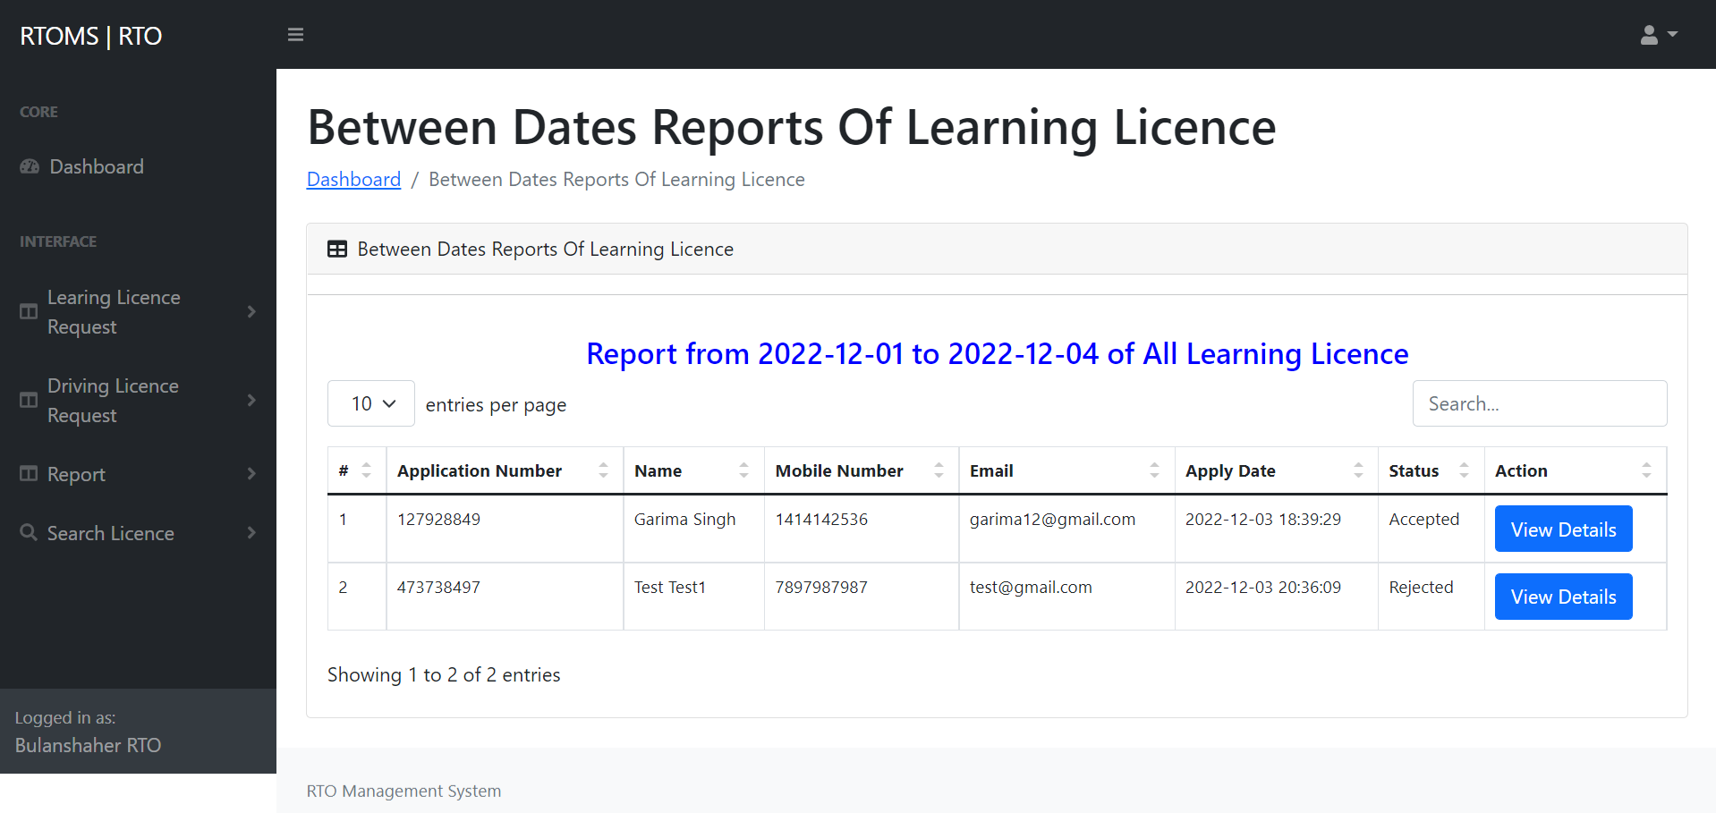
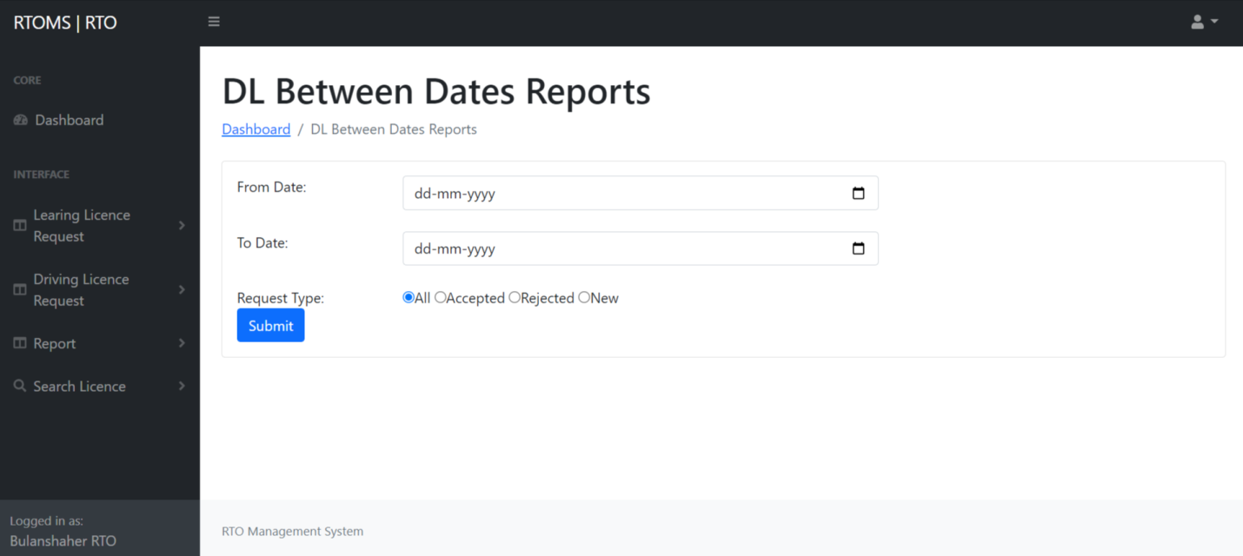

Slide 41
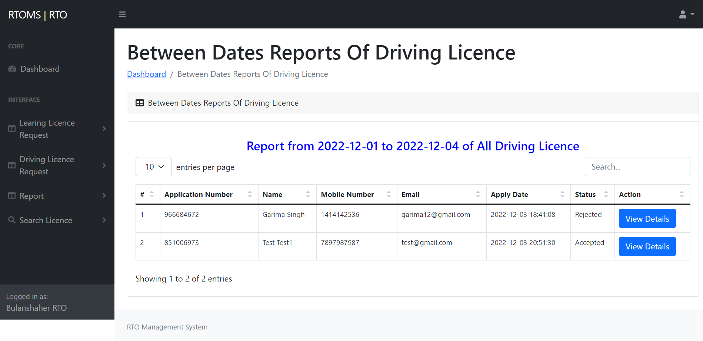
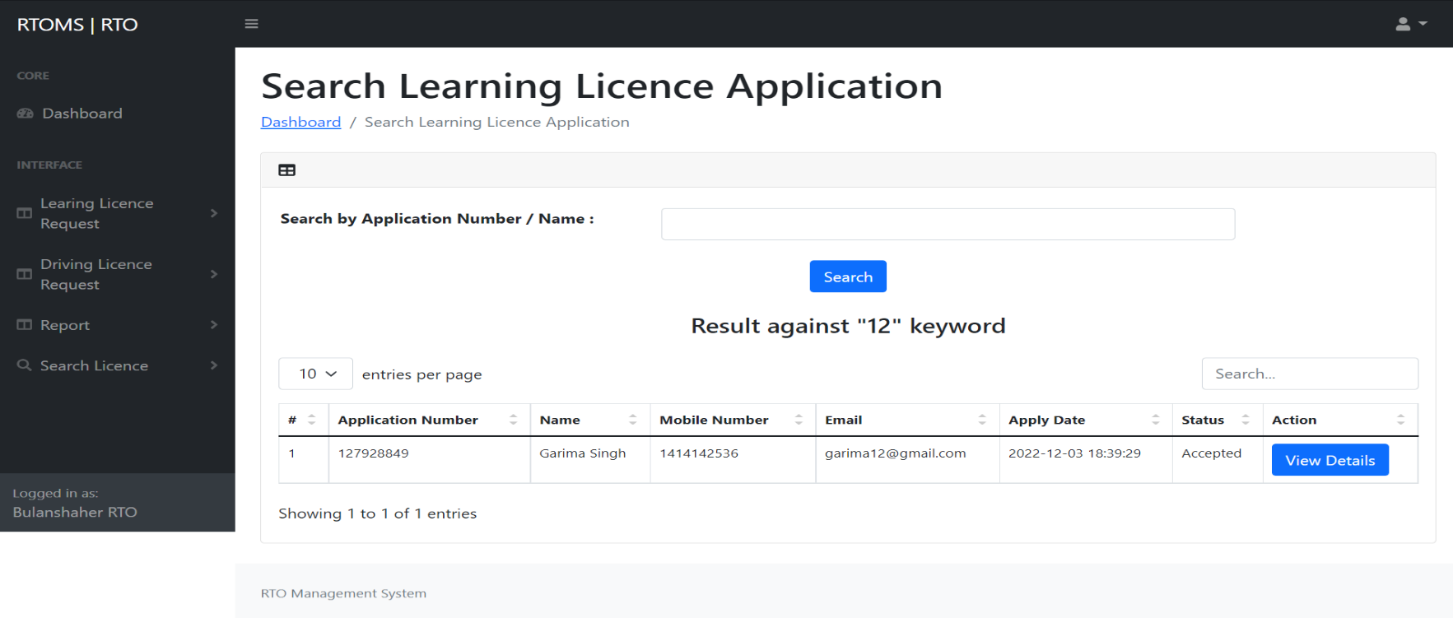

Slide 42
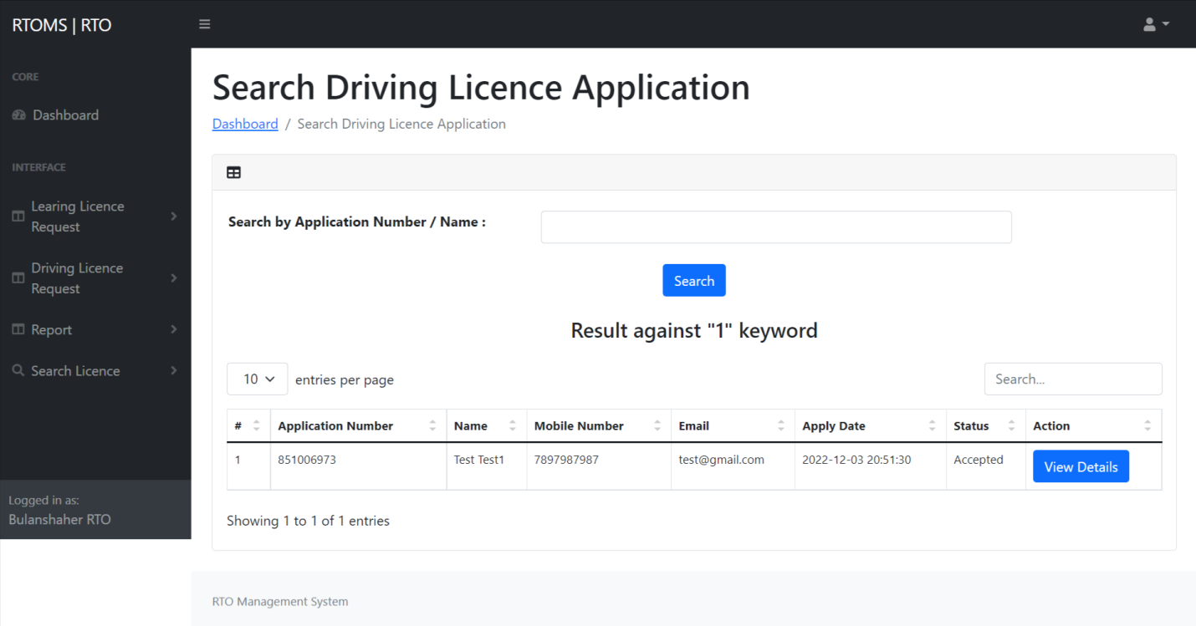
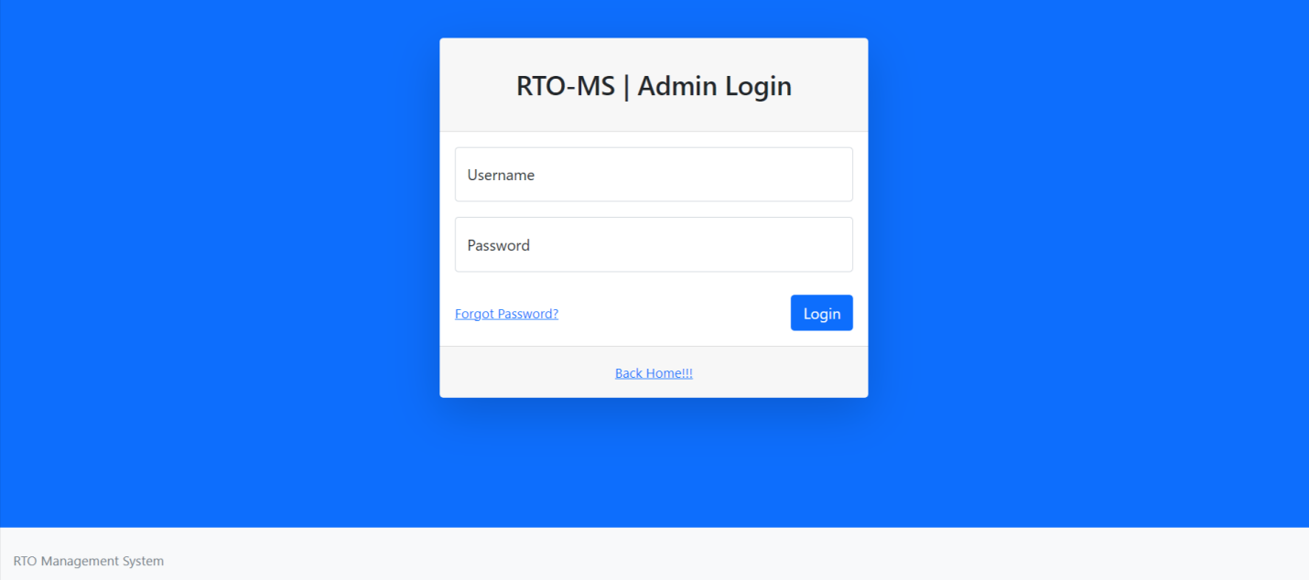

Slide 43
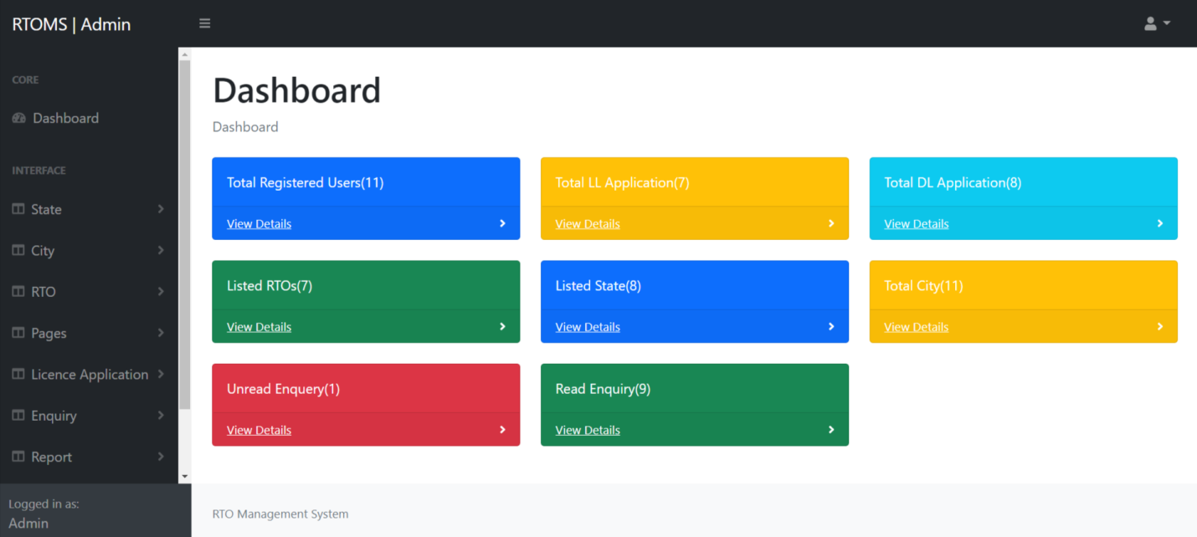
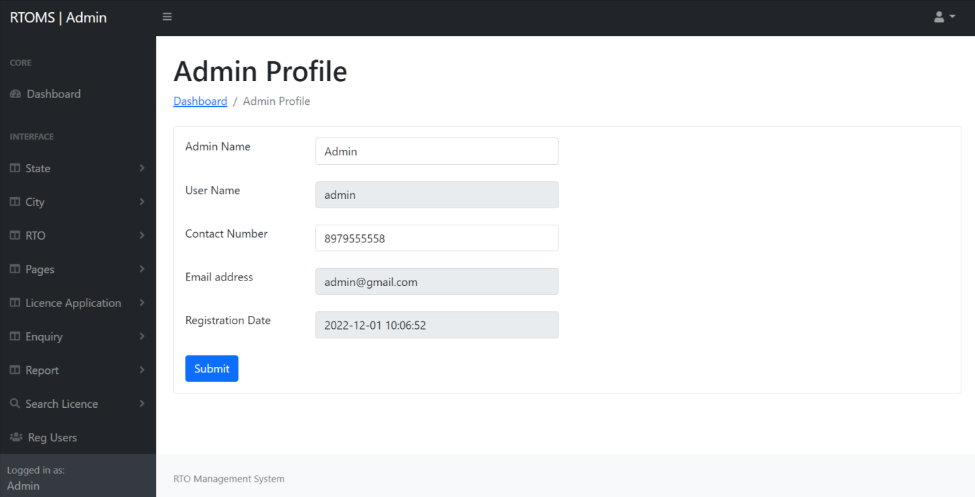

Slide 44
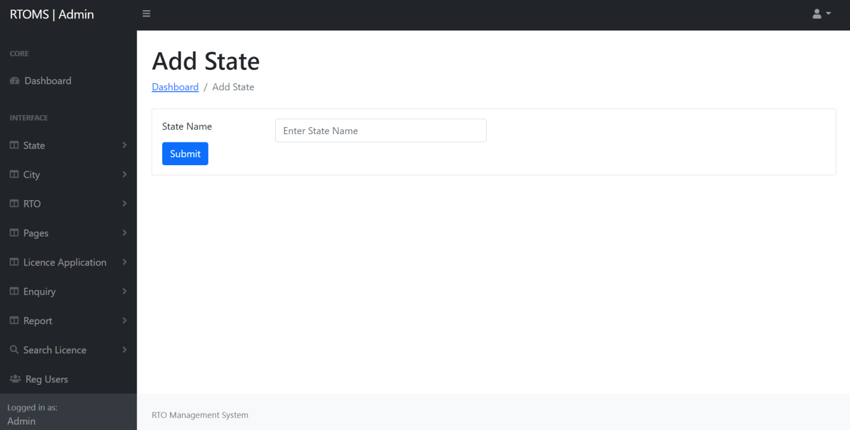
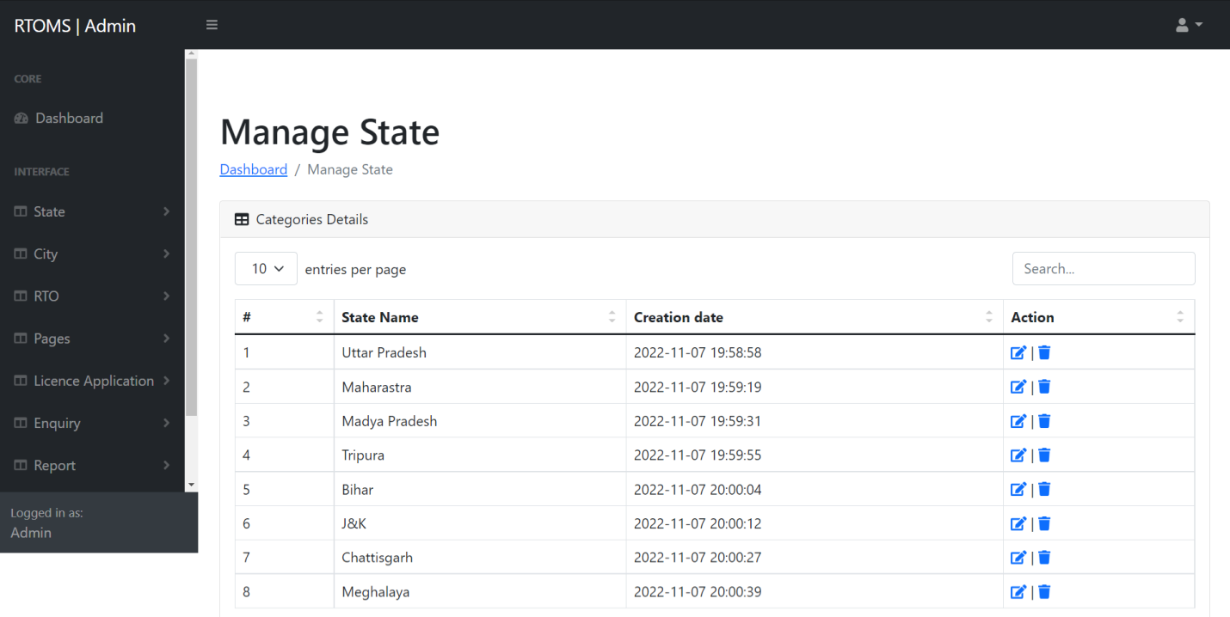

Slide 45

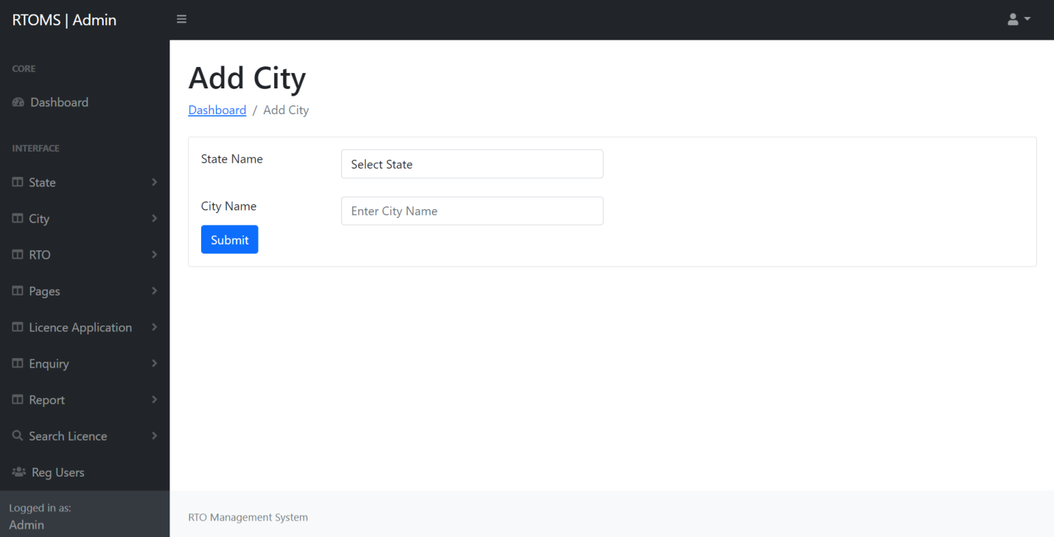

Slide 46
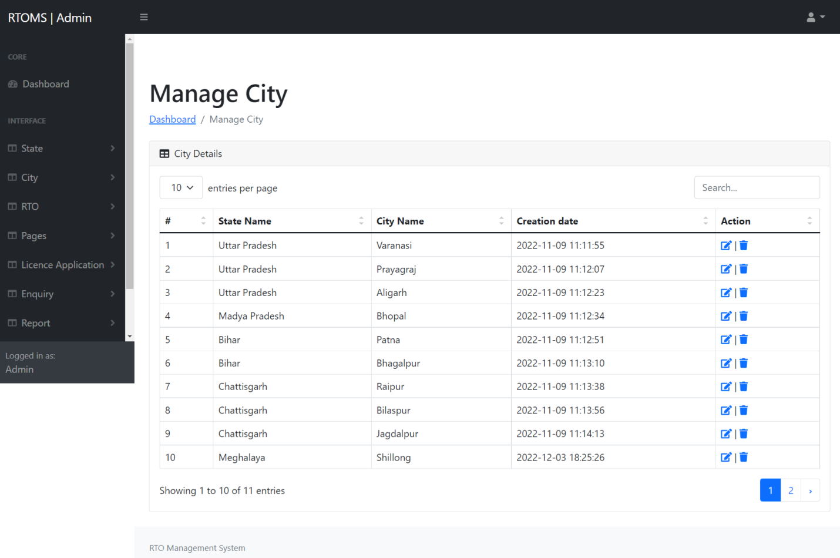
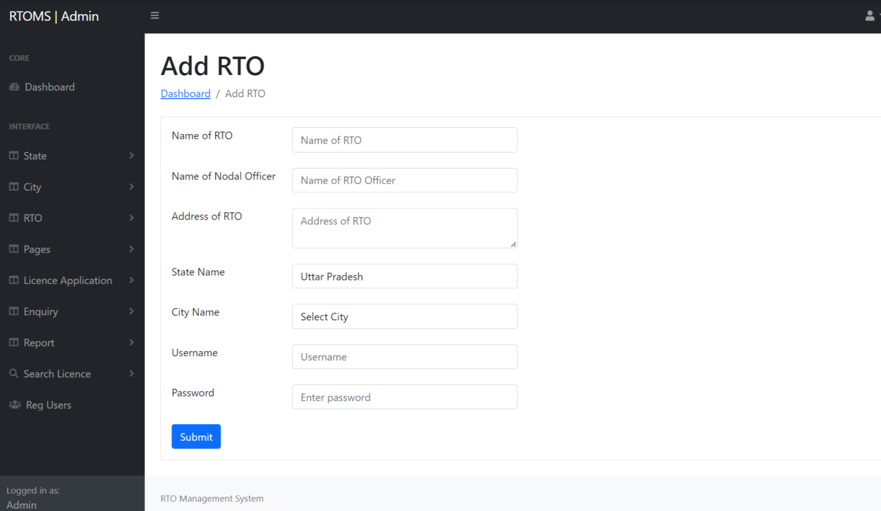

Slide 47
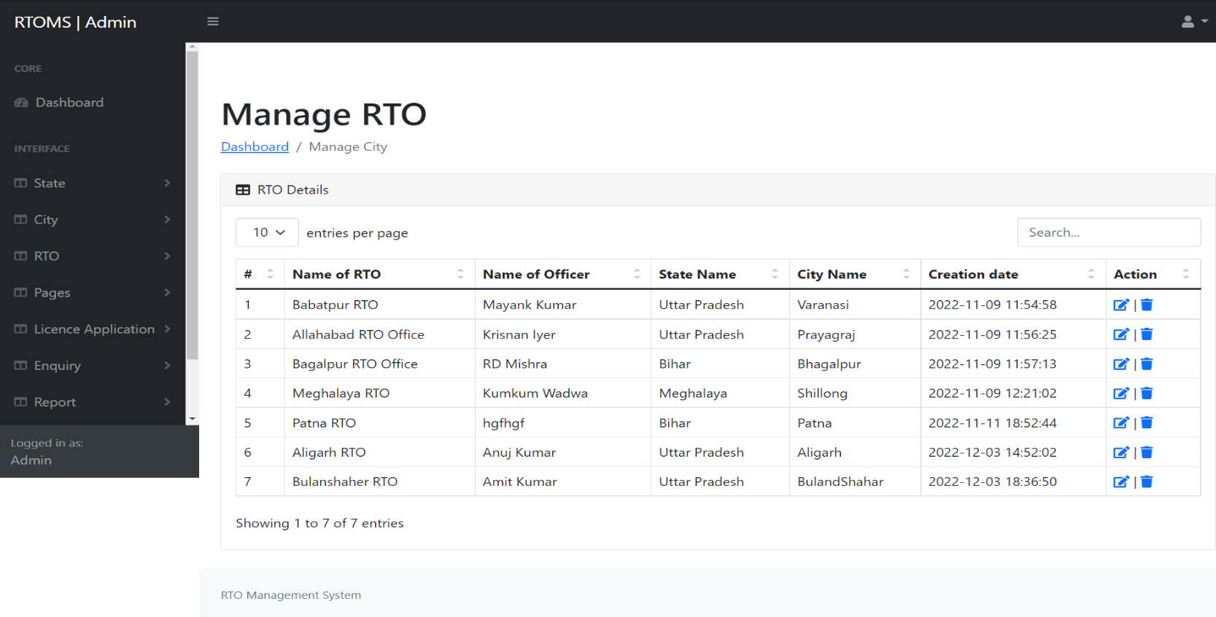
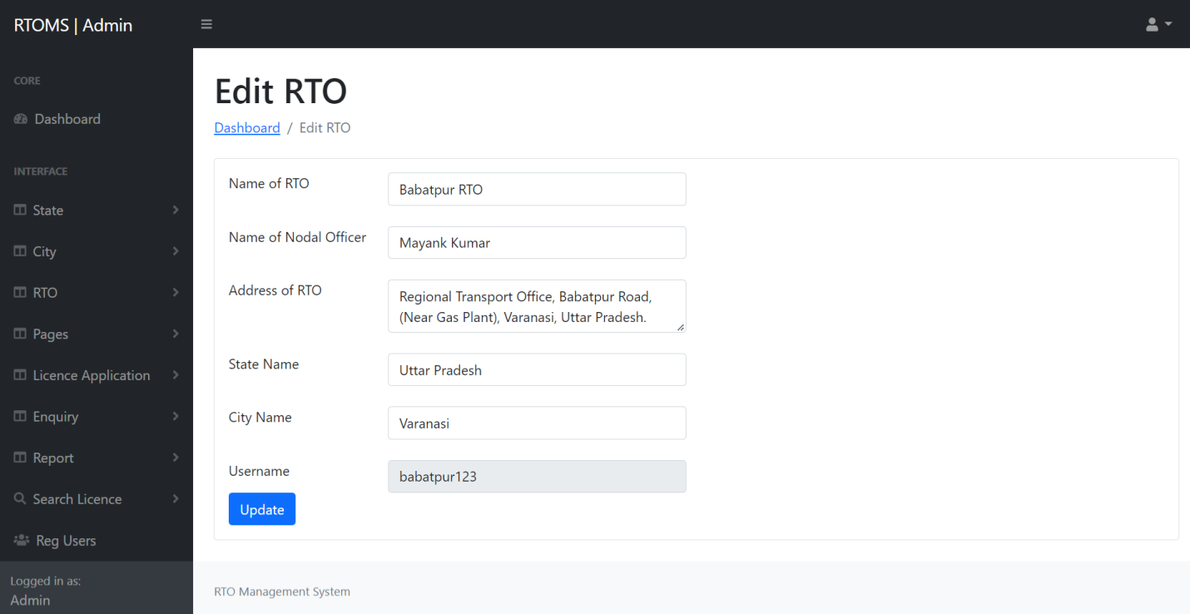

Slide 48
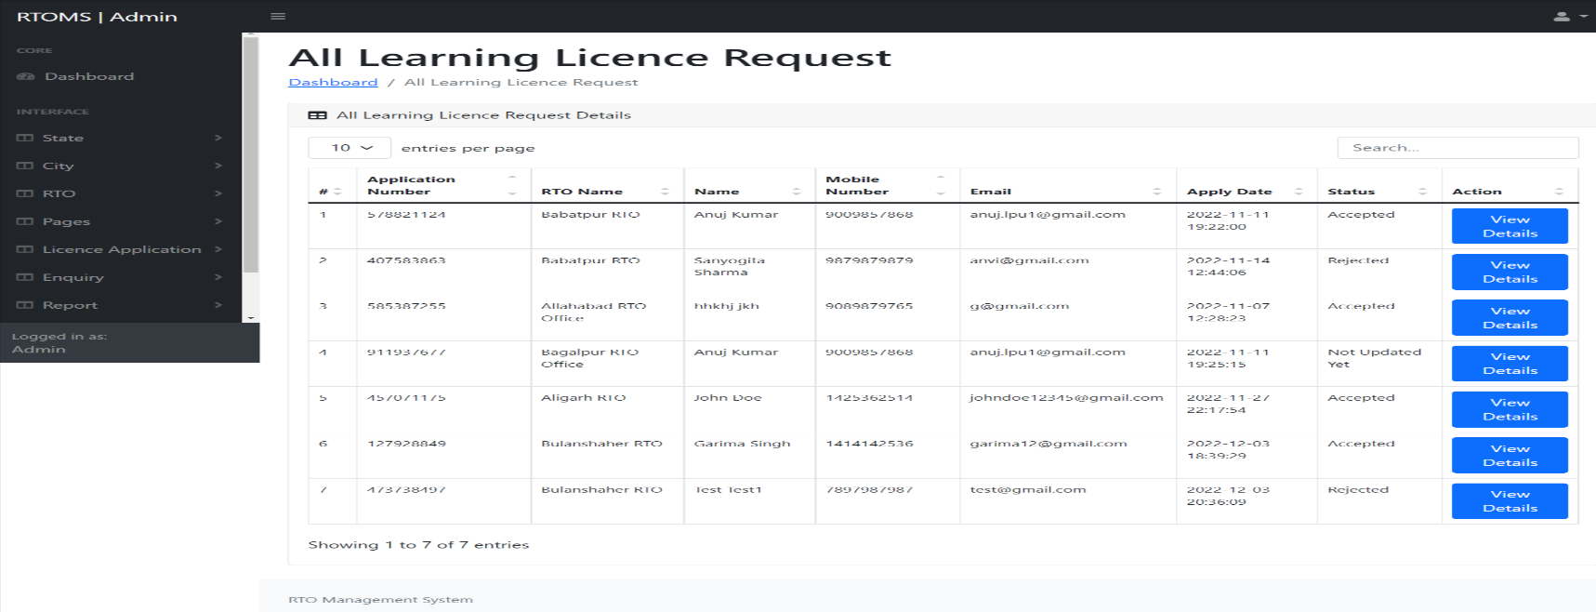
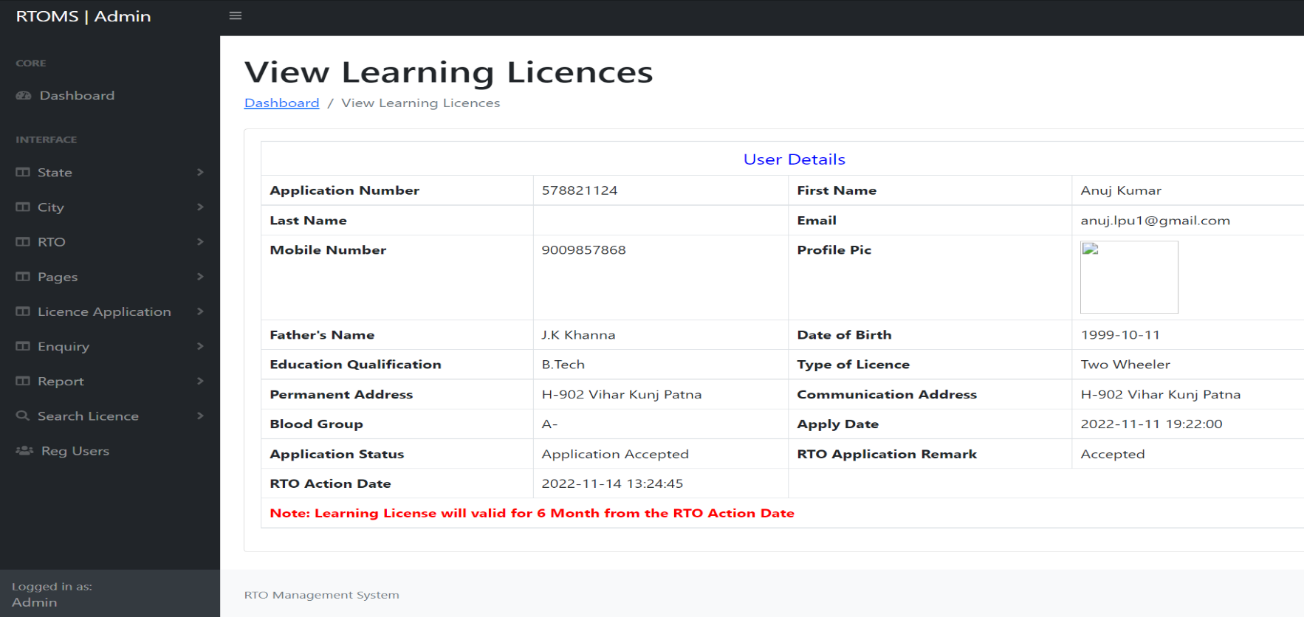

Slide 49
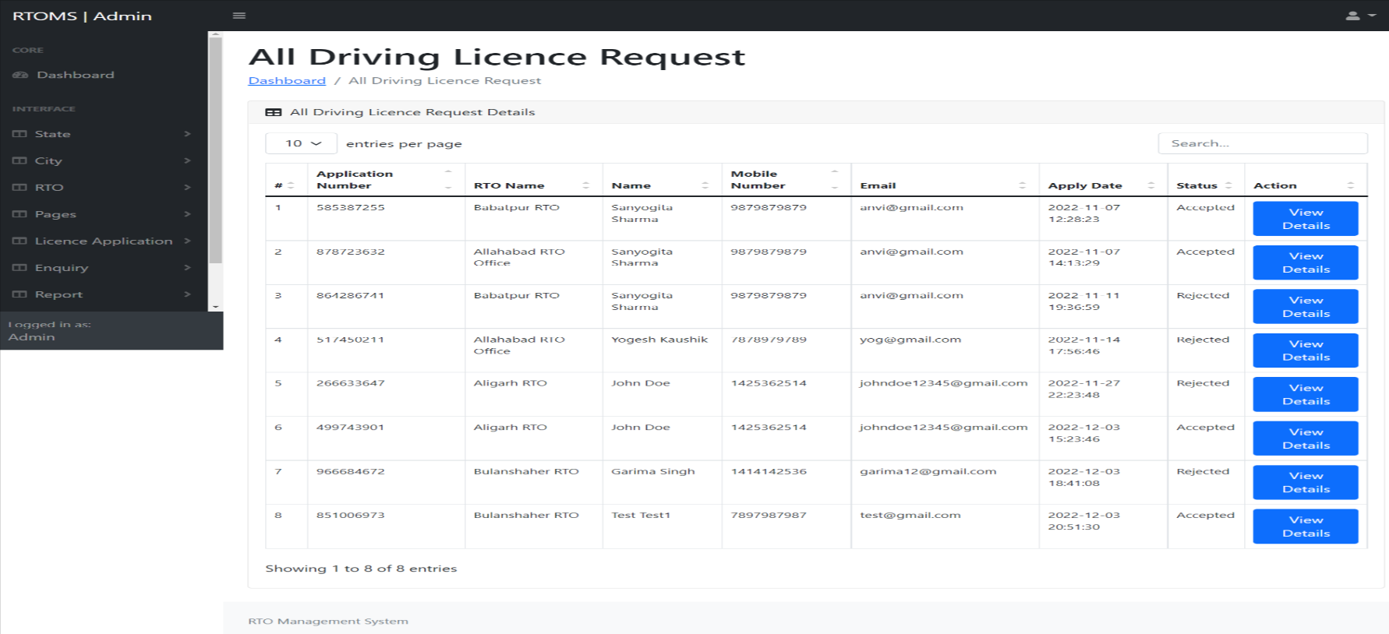
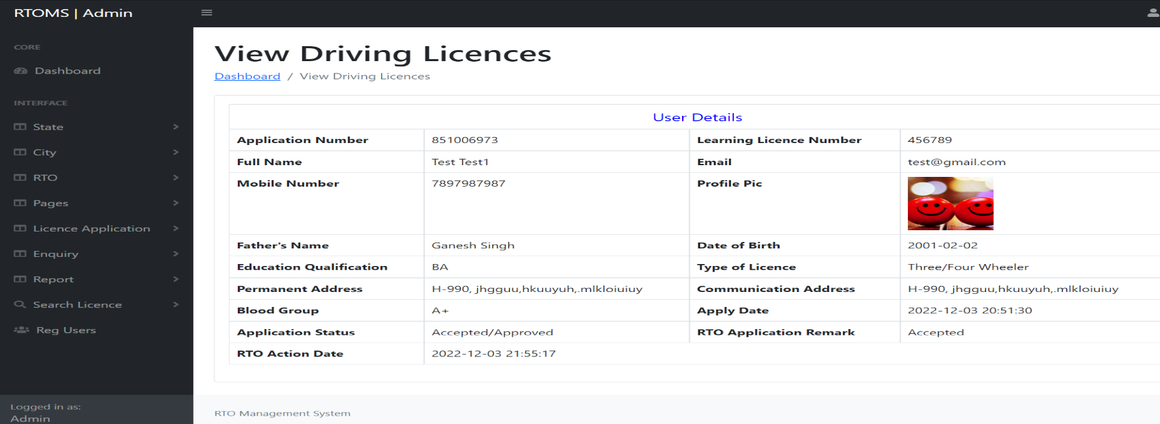

Slide 50



Slide 51



Slide 52



Slide 53



Slide 54



Slide 55
Conclusion
The “RTO Management System” was successfully designed and is tested for accuracy and quality. During this project we have accomplished all the objectives and this project meets the needs of the organization. One of the solutions that we are going to discuss here to speed up the database response by using SQL Server database and to reduce the time complexity by using multi-user environment. Multi-user environment reduces burden with effortless maintenance.
GOALS ACHIVIED
Reduced entry work.
Easy retrieval of information.
Reduced errors due to human intervention.
User friendly screens to enter the data.
Portable and flexible for further enhancement.
Web enabled.
Fast finding of information request.

Slide 56
References
www.w3schools.com
php.net
en.wikipedia.org/wiki/PHP
www.hotscripts.com/category/php/
www.apache.org
www.mysql.com/click.php?e=35050

Slide 57
Thank You

